Slide 1
Lecture 4
Radiation Basics
AOSC 434
AIR POLLUTION
RUSSELL R. DICKERSON

Slide 2
ELECTROMAGNETIC RADIATION
The sun produces essentially all the energy the Earth receives. It powers atmospheric chemistry and drives the circulation of the atmosphere and oceans. Energy decreases with wavelength and most chemical bonds can be broken only by uv radiation.
Planck’s Law
E = hv
Sun emits over most of spectrum.
Black body radiation – Stefan-Boltzmann Law.
E = σT⁴
Wien’s Displacement Law.

Slide 3
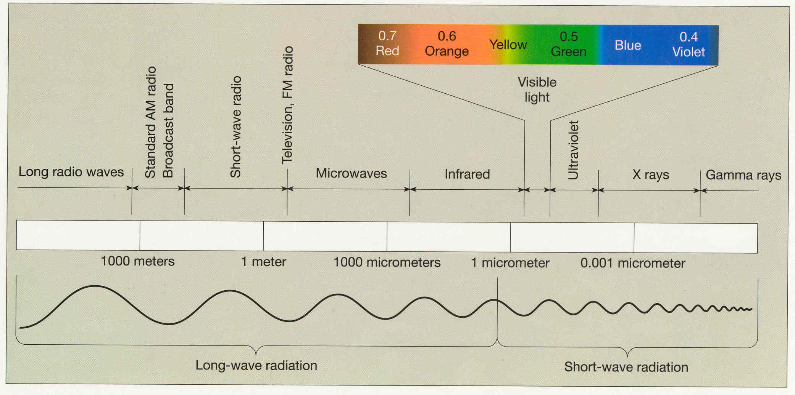
Electromagnetic spectrum

Slide 4
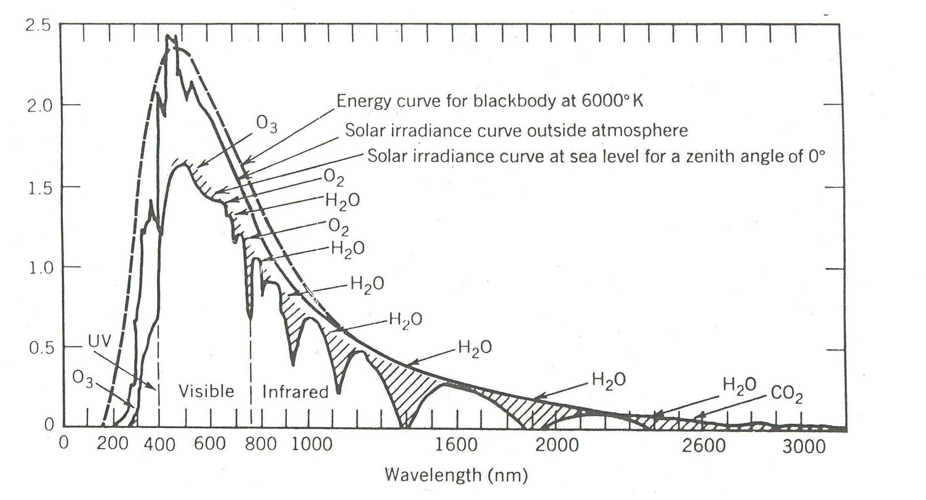
UV-Visible - IR SOLAR SPECTRUM

Slide 5
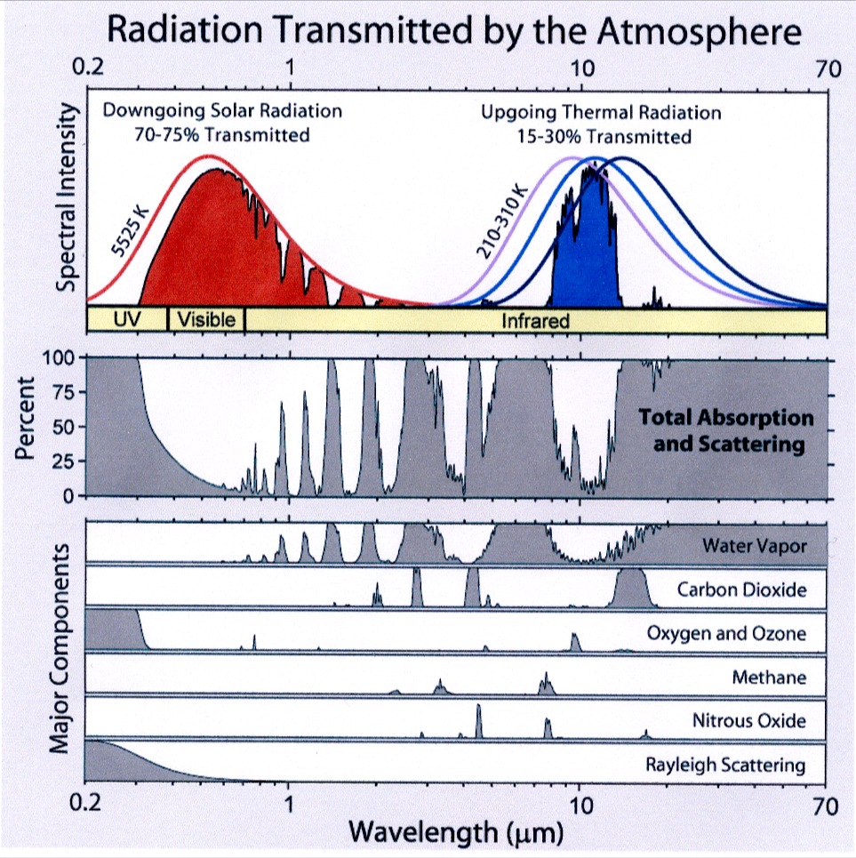

Slide 6
The temperature of the Sun’s photosphere is ≈ 6000 K, therefore the is 483 nm, (blue, towards green). Only a fraction of the total solar radiation reaches the Earth’s surface. The atmosphere controls the amount reaching surface. The Earth, at ≈ 250 K, has a of 9.6 μm or 9600 nm, in the IR.
(1400 Wm⁻² reach outside of our atmosphere).
E = Energy of a photon
h = Planck’s constant
v = Frequency
c = Speed of light
a = Wien’s constant

Slide 7
Planck’s Law for blackbody radiation:
Take first derivative wrt T and set to zero: Wien’s Law:
Integrate over all wavelength: Stephan-Boltzmann Law:

Slide 8
Planck’s Law says that the energy of a photon is proportional to its frequency.
Where Planck’s Const., h = 6.6x10⁻³⁴ Js
The energy associated with a mole of photons at a given
wavelength in nm is:

Slide 9
Summary: the Stephan Boltzmann Law and Wien’s Law are a consequence of Planck’s function:
Differentiate wrt λ and find maximum to get Wien’s Law.
Integrate wrt λ to find Stephan Boltzmann Law.
Atmospheric O₂ and O₃ absorbs most of UV.
H₂O & CO₂ absorbs most of IR.
Small fraction of atmospheric gases do most of the absorbing.
Visible “window”
IR window between 8 to 10 μm (note ozone)
Ozone sets solar intensity in UV at the Earth’s surface
Seasons are caused by the tilt of the Earth. The angle of incidence (not the distance for the sun) controls the amount of radiation reaching a given area.

Slide 10
Sun
The sun appears more nearly overhead in summer than in winter.
α
EARTH
Sun
Zenith
SURFACE

Slide 11
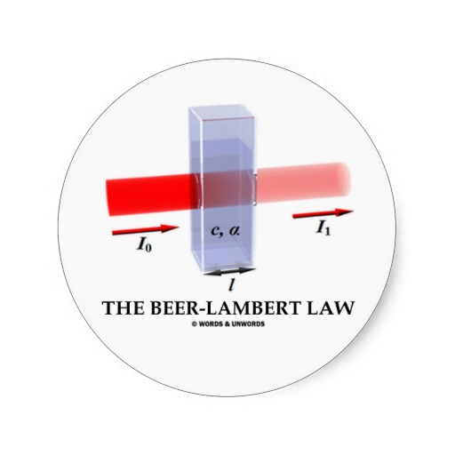
The amount of radiation available for the production of photochemical smog also depends on the angle of incidence – there is more “smog” in the LA summer than winter; Washington and Baltimore violate the ambient air quality standard for ozone in the summer, but not the winter.
BEER’S LAW
If we define absorption as follows:
Then a doubling of the concentration or a doubling of the path length will double the absorption.

Slide 12
Near zero this is linear; for example, if the absorption, σcl, is 10⁻³ then I/I₀ = 0.999.
Consider the impact of the solar zenith angle on path length:
Sun
Zenith

Slide 13
Thermodynamics and Radiation
First Law of Thermodynamics: Energy is heat plus work.
U = Q - W 1
dU = đQ - đW
The internal energy, U, in Eq. 1 is an “Equation of State,” that is dependent only on the initial and final states or path independent. Remember that Equations of State are exact differentials indicated with a “d”. Chemical reactions involved in air pollutions occur at constant pressure, thus it is important to know if the heat exchanged in these reactions is path independent.
Enthalpy, Bond Energy, and Entropy
Enthalpy is defined as:
H = U + PV

Slide 14
Absolute values of enthalpy do not exists, thus we talk of changes in enthalpy.
ΔH = ΔU + Δ(PV)
dH = dU + VdP + PdV
Note that when the only work done is PdV work and when the pressure is constant (dP = 0) enthalpy is identical to heat.
dU = DQ + PdV + VdP
dH = DQ + PdV = VdP - VdP + PdV
Chemical and physical systems then toward the lowest enthalpy. Enthalpy, or heat, of formation is given the symbol ΔH_{f} and is the heat released or absorbed in the formation of a substance from its elements. A superscript o indicates standard conditions. Not that “standard” temperature for thermodynamic properties is 25 ⁰C not 0 ⁰C.
(SEE TABLE; also back of Pitts’ book.)

Slide 15
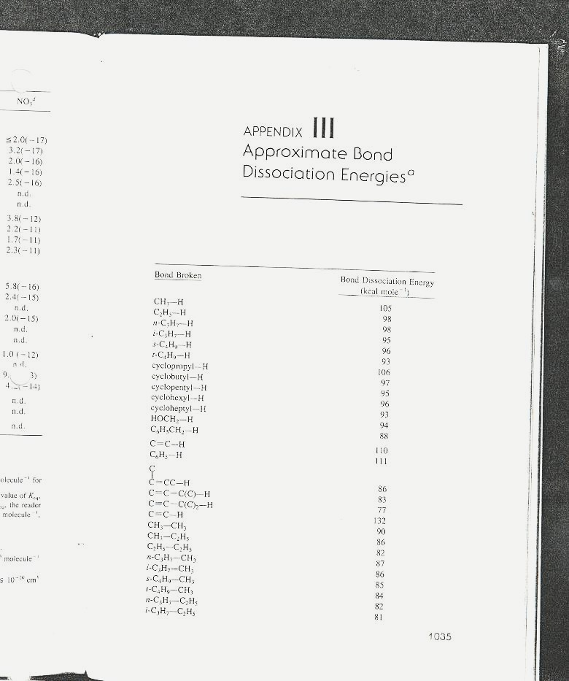

Slide 16
Elements in their most stable state at RTP (e.g. O₂, N₂, H₂, C_{graph}) are defined as having ΔHf° of zero. The change of heat in reaction is the sum of the heats of formation of the products minus the sum of the heats of formation of the products.
In general “combustion” is the process of oxidation to CO₂ and H₂O. The combustion of coal (C) to CO₂ is the same as the heat of formation of CO₂ because the reactants are elements in their most stable state.
C + O₂ → CO₂
Consider the combustion of isooctane (C₈H₁₈) which is an approximation of gasoline. Note that the ratio of N₂ to O₂ in air is 3.76.
C₈H₁₈ + 12.5 O₂ (+47N₂) → 8CO₂ + 9H₂O (+47N₂)

Slide 17
We can by the way calculate the amount of air needed to cause complete combustion, and from it the “air-fuel-ratio” (AFR).
12.5*32 g/mole + 47*28 g/mole = 1716 g air
12*8 + 18 = 114 g fuel
1716/114 = 15 g air/ g fuel
AFR = 15:1
If we assume complete combustion, then CO₂ and H₂O will be the only products.
LOTS OF HEAT!
The amount of heat from 114 g of gasoline is sufficient to boil 15 L of water if none of the heat escapes.

