Slide 1
Satellite Measurements of
Trace Gases or Air Pollutants
Orbits, measurement types, spectral regions, properties

Slide 2
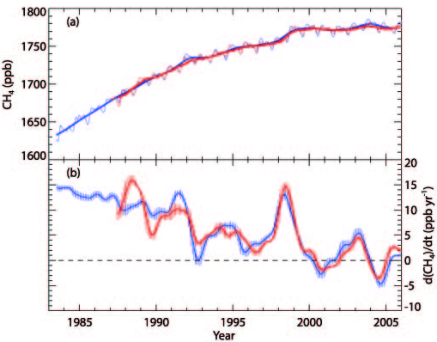
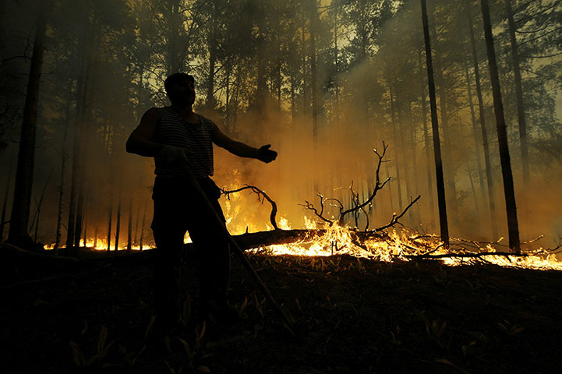
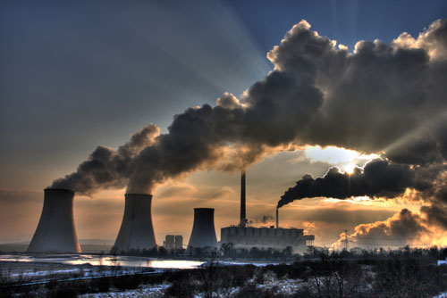

Satellite monitoring of the changing world
- daily global coverage & longterm
Climate Change
Inter-continental
Transport of air pollution
Extreme Weather
Notes:
These events are not isolated! The feedbacks and interdependence are complicated.

Slide 3
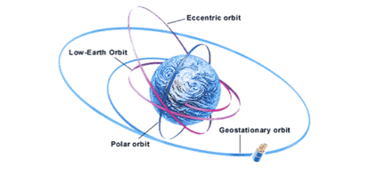
Satellite Orbits
There are different types of orbits around the Earth of varying sizes and each is used for a particular objective:
http://www.wisedude.com/science_engineering/satellites.htm
The Eccentric orbit holds a satellite that measures the Earth's magnetic and electric fields. This orbit is conducive for this purpose, since the satellite can obtain measurements at different distances from Earth.
The Low Earth orbit is said to be the easiest to reach and is where the Russian space station and Hubble Space Telescope both orbit.
The Polar orbit is, as its name suggests, concentrated around the Earth's poles. Weather satellites are placed here as readings of the entire Earth can be taken while the planet spins.
The Geostationary orbit is about 35, 880 km above the Equator and holds communication satellites, especially television satellites. Both the Earth and the satellites complete their respective circles at the same time, meaning they move neck-to-neck.

Slide 4

Atmospheric Radiation Spectrum
Satellite remote sensing uses four spectral regions.
Focus in IR region and species focus on atmospheric composition and greenhouse gases.
UV: Photochemistry happens:
some absorptions (e.g., O₃) + profile information; aerosols
VIS: surface information: vegetation; some absorptions; aerosol information
IR: profile information: temperature information; cloud information; water / ice distinction; many absorptions / emissions from atmospheric composition
MW: no problems with clouds: ice / water contrast; surfaces; some emissions + profile information

Slide 5
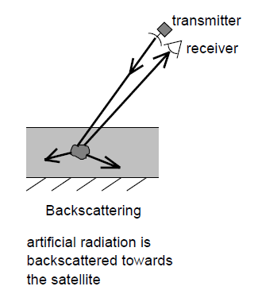
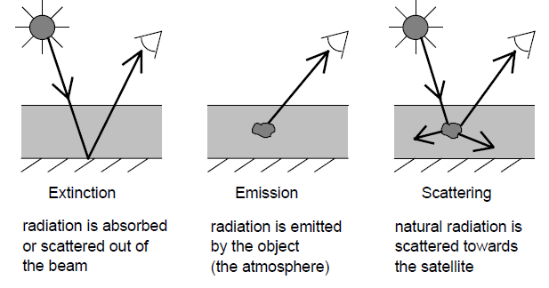
ACTIVE VS. PASSIVE REMOTE SENSING
Passive Remote Sensing:
Natural sources of radiation, the attenuated, reflected, scattered, or emitted radiation is analysed
Usually UV, visible, IR
Sources include: sun, moon, Earth
Active Remote Sensing:
Artificial source of radiation, the reflected or scattered signal is analysed
Usually lasers (LIDAR) or RADAR
Active source, usually co-located with receiver
Notes:
Am not going to cover the whole topic of optics and instrument design here… or calibration

Slide 6

Thermal Emission Measurements (IR, microwave)
Examples: AIRS, IASI, MLS, IMG, MOPITT, MIPAS, TES, HIRDLS, CrIS
NADIR
VIEW
LIMB VIEW
ε_{λ}I_{λ}(T₁)
T₁
Absorbing gas
versatile (many species)
small field of view (nadir)
vertical profiling
Pros:
I_{λ}(T_{o})
T_{o}
EARTH SURFACE
low S/N in lower troposphere
H₂O and other interferences
Cons:
http://www.atmos.colostate.edu

Slide 7
Solar Backscatter Measurements
Examples: TOMS, GOME, SCIAMACHY, MODIS, MISR, OMI, OCO
λ₁
λ₂
z
sensitivity to lower troposphere
small field of view (nadir)
Pros:
Scattering by
Earth surface
and by atmosphere
Daytime only
Column only
Interference from stratosphere
Cons:
http://www.atmos.colostate.edu
Notes:
SBUV is the same as DOAS but DOAS is surface (one sun beam), SBUV is reflected solar

Slide 8
LIDAR MEASUREMENTS (UV to near-IR)
Examples: LITE, GLAS, CALIPSO
Pros:
High vertical resolution
Laser pulse
Aerosols only (so far)
Limited coverage
Cons:
Intensity of return vs. time lag
measures vertical profile
backscatter by
atmosphere
EARTH SURFACE
http://www.atmos.colostate.edu

Slide 9
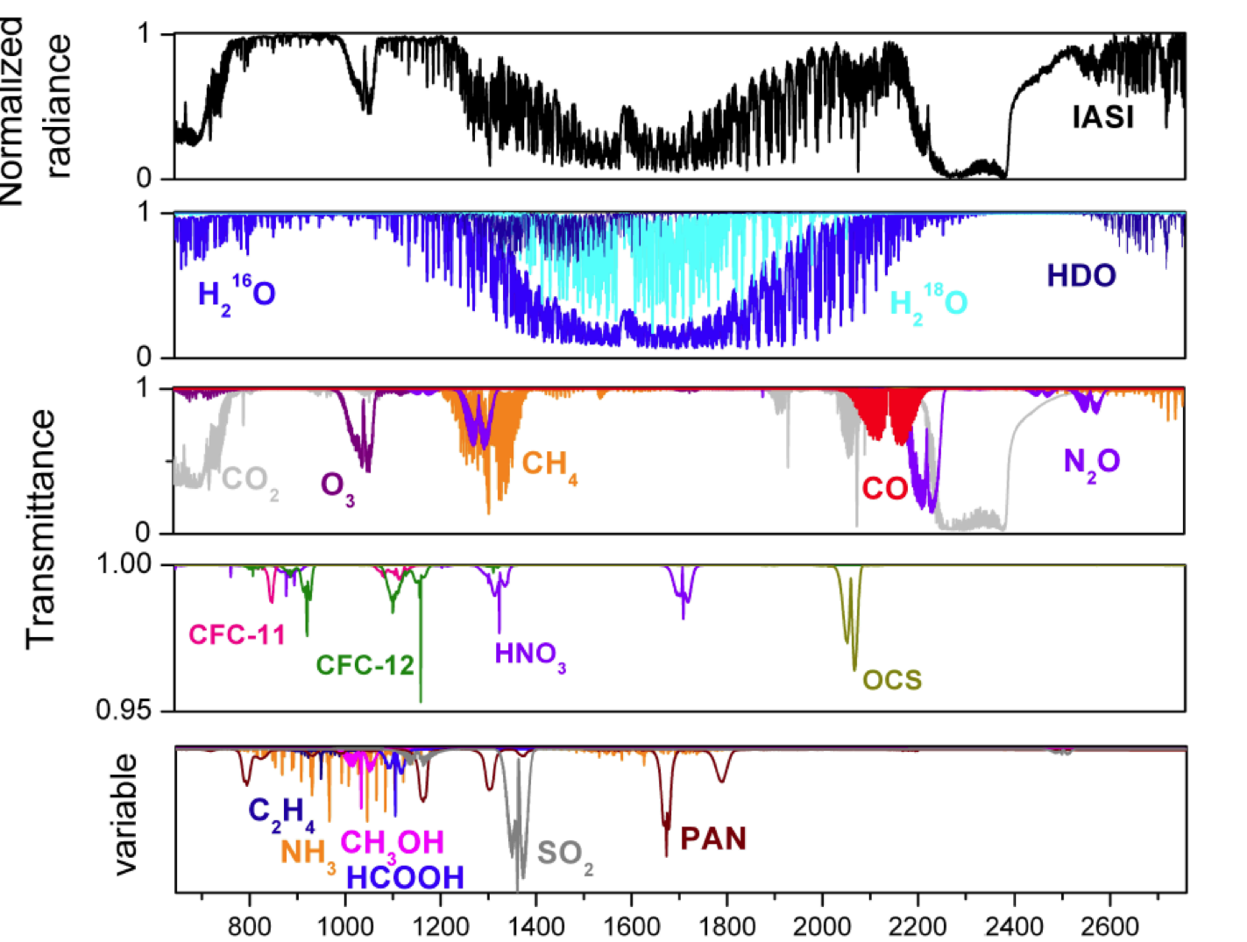
Numerous Species from IR
[Clerbaux et al., ACP 2009]
Notes:
NH3: 10.3-10.4 um (960-972 cm-1)
CH4: 7.6 um (1306 cm-1) also 3.3 um (3020 cm-1) which is not visible in figure
SO2: 7.3 um (1362 cm-1 in figure), also 8.7 um (1152 cm-1) and 4 um (2500 cm-1)

Slide 10
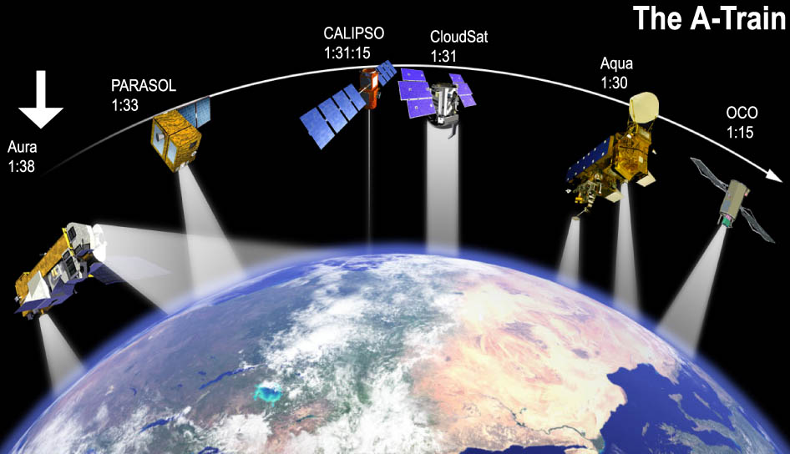
A-Train Satellites
multiple |  | ERS-2 | Adeos | Terra |  | EnviSat |  | Aqua | Space sta. | SCISAT -1 | Aura |  |  |  |  | MetOp –A&B | NPP
TOMS | AVHRR/ SeaWIFS | GOME | IMG | MOPITT | MODIS/MISR | SCIA-MACHY | MIPAS * | AIRS/MODIS | SAGE-3 | ACE-FTS* | TES | OMI | MLS* | HIRDLS* | CALIPSO/Cloud Sat | IASI | CrIS/VIIRS/OMPS | OCO-2
1979 |  | 1995 | 1996 | 1999 | 1999 | 2002 | 2002 | 2002 | 2004 | 2003 | 2004 | 2004 | 2004 | 2004 | 2004 | 2007 | 2011 | 2014
Besides traditional temperatures, water vapor, etc.:
O₃, CO, CO₂, NO, NO₂, HNO₃, CH₄, HCHO, CHOCHO, SO₂, BrO, CH₃CN, HCOOH, CH₃OH, NH₃, HDO, Aerosols, Clouds

Slide 11
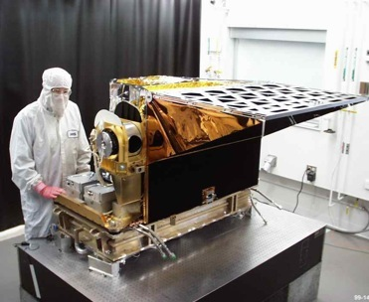
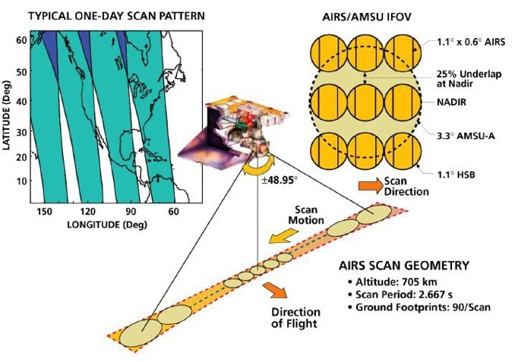
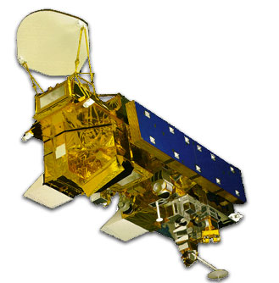
Atmospheric Infrared Sounder
Launched May 2002
A grating spectrometer originally designed to improve weather forecast and now also used for climate and air quality studies.
Spectral resolution at /1200 (~ 0.5 cm⁻¹)‏
Covers 650-2665 in three bands with a total of 2378 channels
Spatial resolution 13.5 km² (with retrievals at ~45 km²)
Wide swaths and cloud clearing provide daily global coverage
Very high Signal-to-Noise accuracies of 1K over 1 km-layer.
AQUA
AMSU
AMSR-E
HSB
MODIS
AIRS
CERES
Notes:
Spectral plots – check email to find UMBC talk.
11

Slide 12


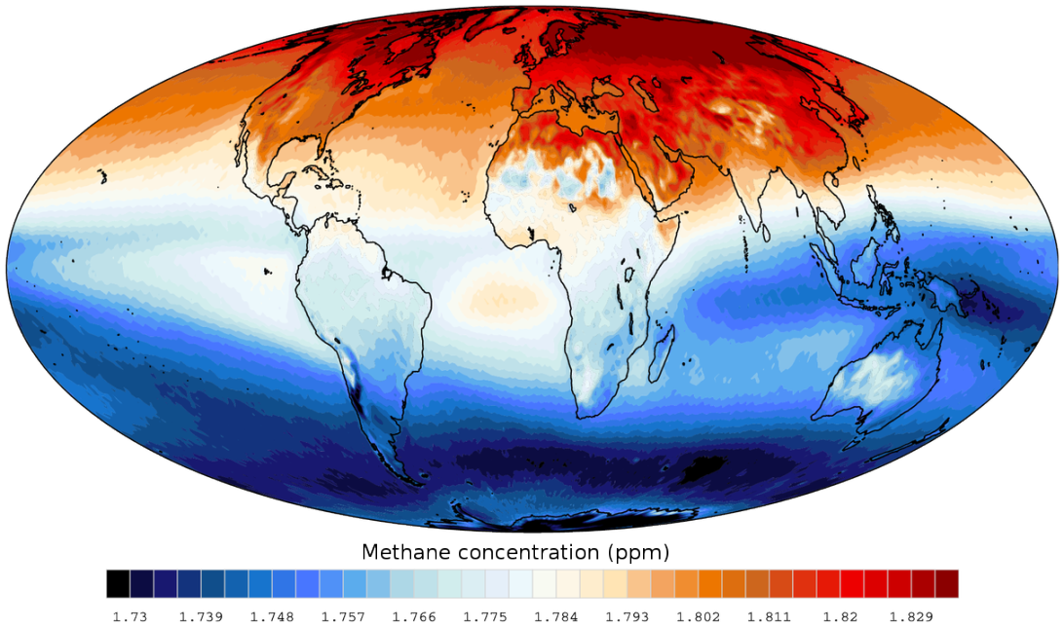
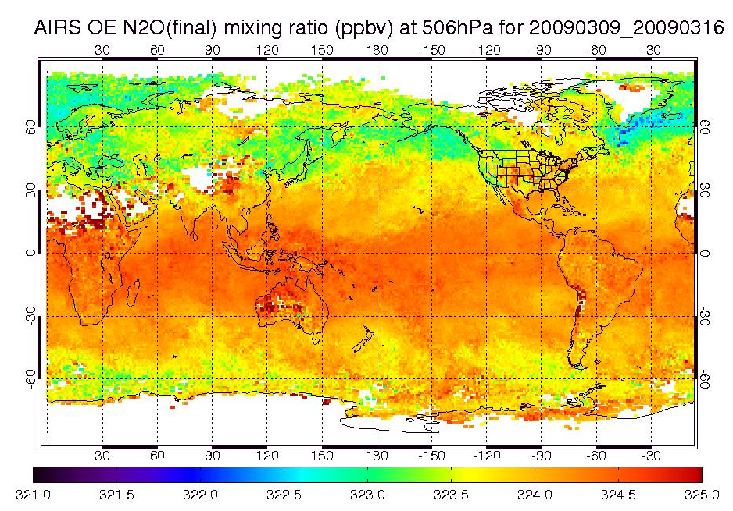


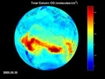

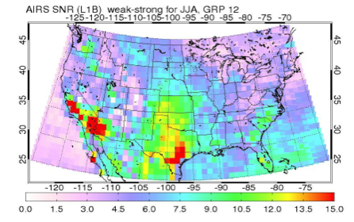


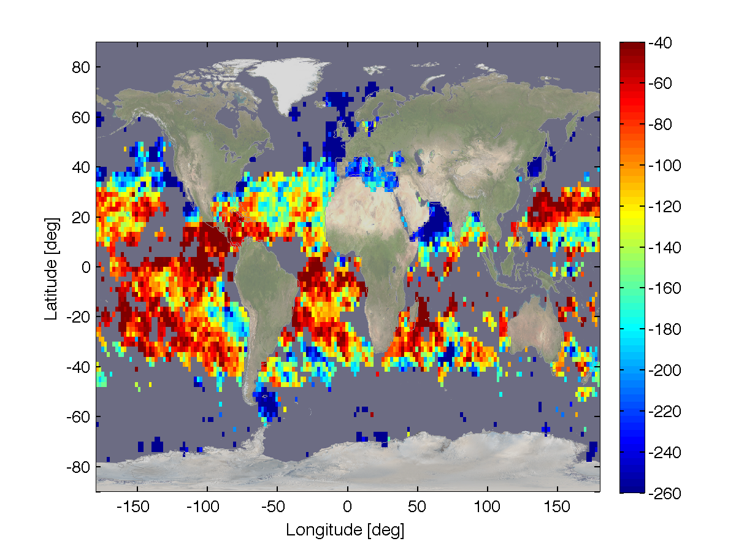
Atmospheric Infrared Sounder
H2O
OLR
CH₄
O₃
Temp
N₂O
CO
Cloud
NH₃
SO₂
CO₂
HDO

Slide 13
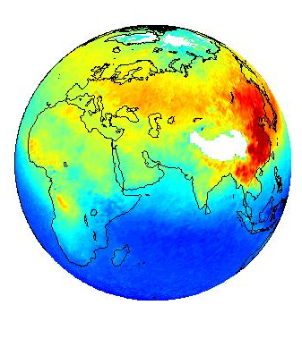
Inverse Methods
Forward Model
CONCENTRATIONS
RADIANCE
Inverse Model
y = F(x, b) + ε
y - vector of wavelength-dependent radiances (radiance spectrum);
x - state variable of concentrations;
F(x, b) - forward model using Radiative Transfer Equations (RTE);
b - other properties, besides x, needed to model the atmosphere.
http://www.atmos.colostate.edu

Slide 14
Retrieval Difficulty
- Use Prior Knowledge in Retrievals
Problems:
Non-uniqueness of solution (need to apply a priori information)
Discreteness of measurements of a smoothly varying function
Instability of the solution due to errors in the observations

Slide 15
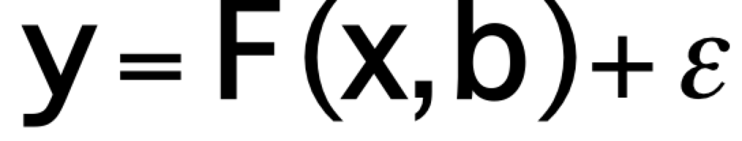
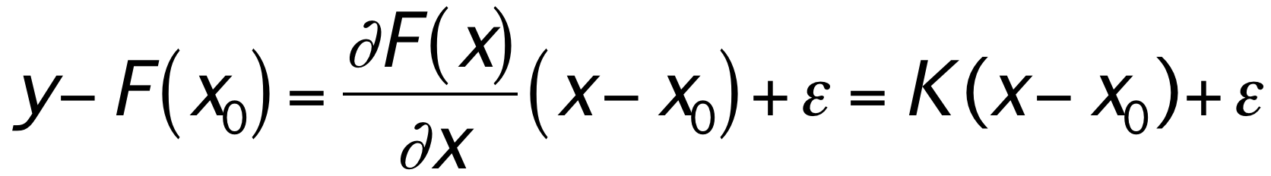
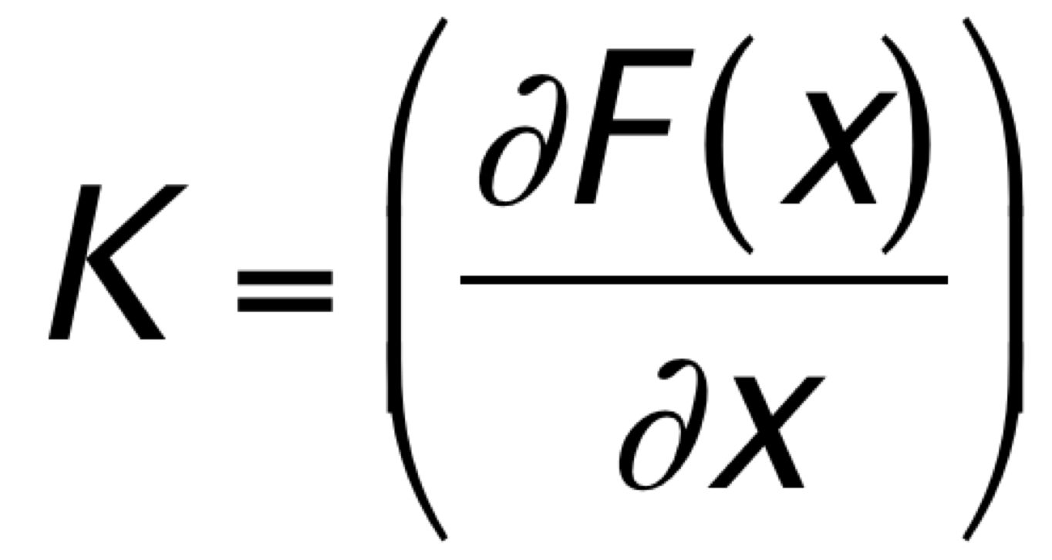
FORWARD MODEL
Observations
(e.g. radiation)
State of interest
(e.g. concentrations)
Complementary parameters
Errors
If linear (or linearize the forward model about some reference state X₀):
Where is the weighting functions or Jacobians.
This problem is ill-posed because K (mxn) is not square (generally m < n, i.e., less measurements than unknowns).
Notes:
En présence d’erreurs (ε≠0), seule une solution statistique est possible.
On doit utiliser une information « a priori » sur la solution recherchée: moyenne et variabilité.
On va rechercher une estimation optimale de x.

Slide 16
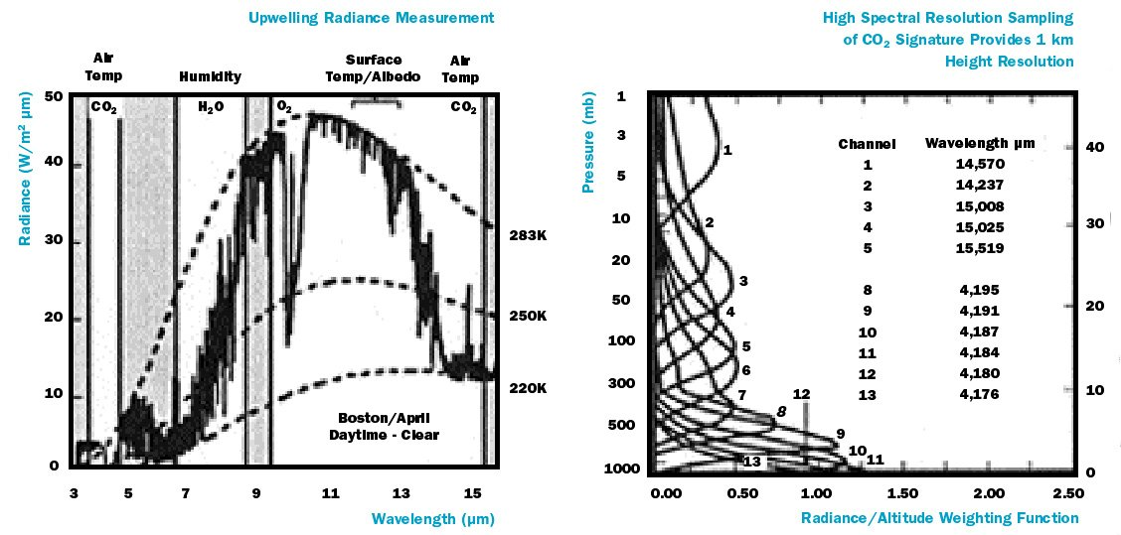
Weighting Functions
Courtesy of Dr. DeSouza-Machado, UMBC
Notes:
Spectral plots – check email to find UMBC talk.
16

Slide 17
Jacobians-measurement sensitivity for a specie in a spectral band
Courtesy of Dr. DeSouza-Machado, UMBC

Slide 18
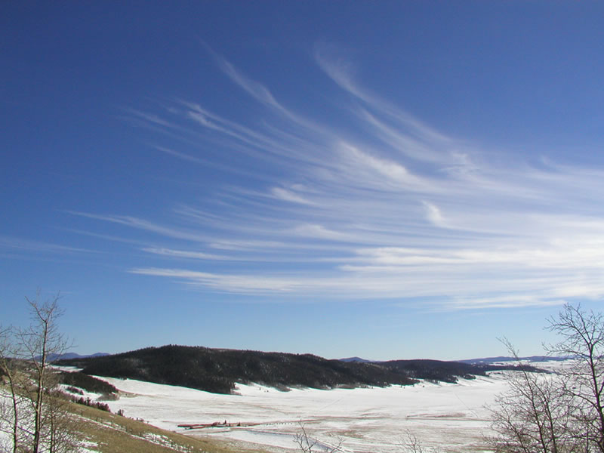
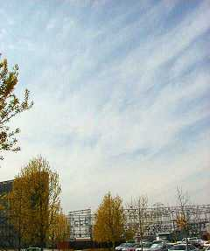
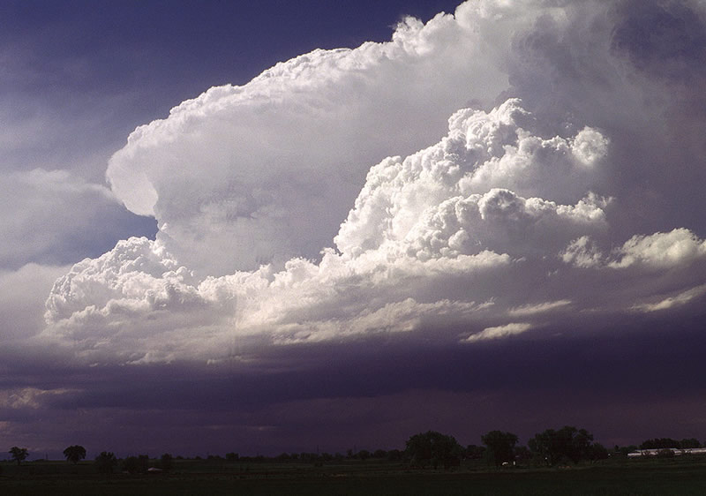
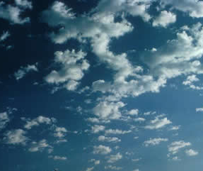
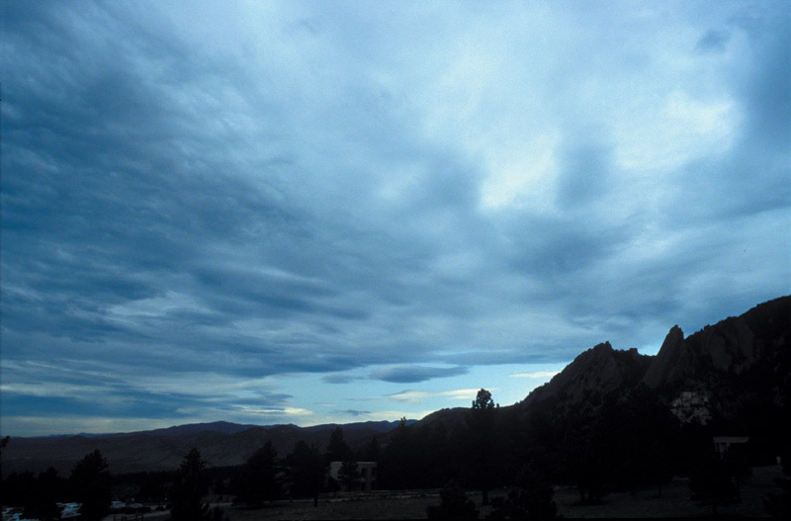
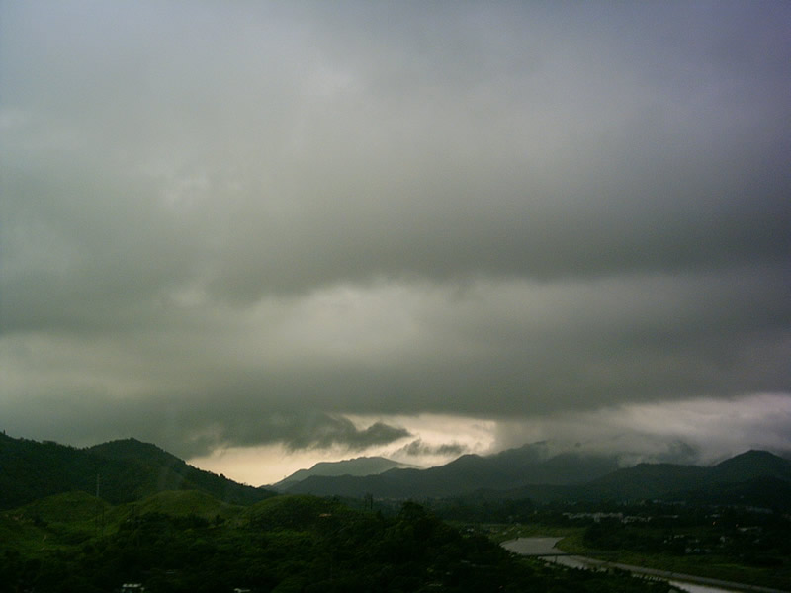
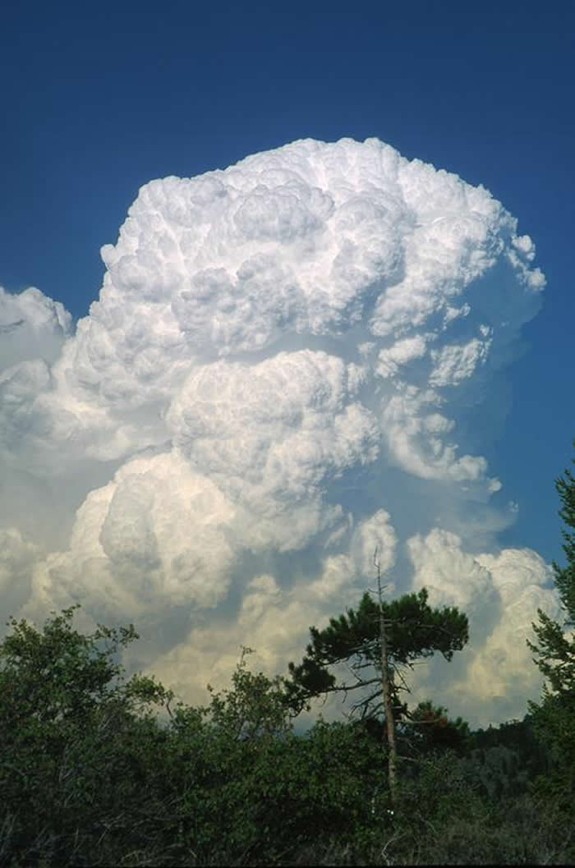
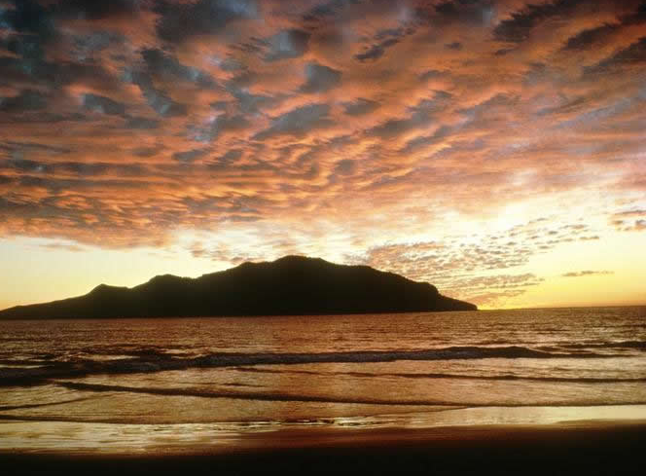
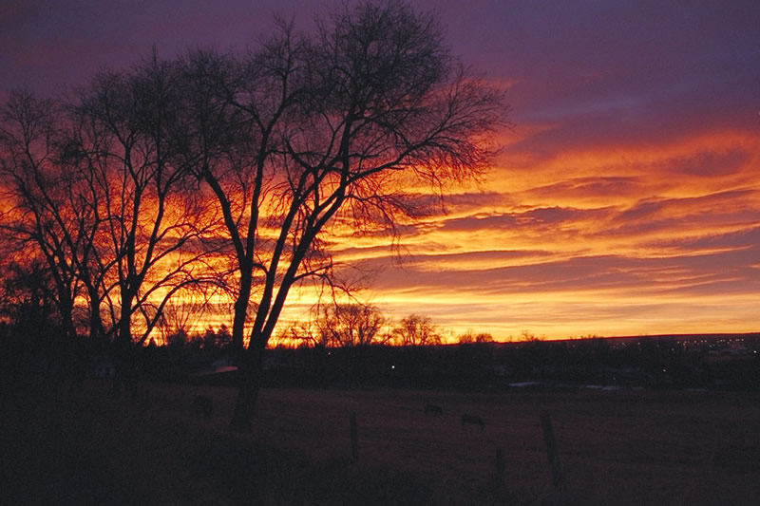
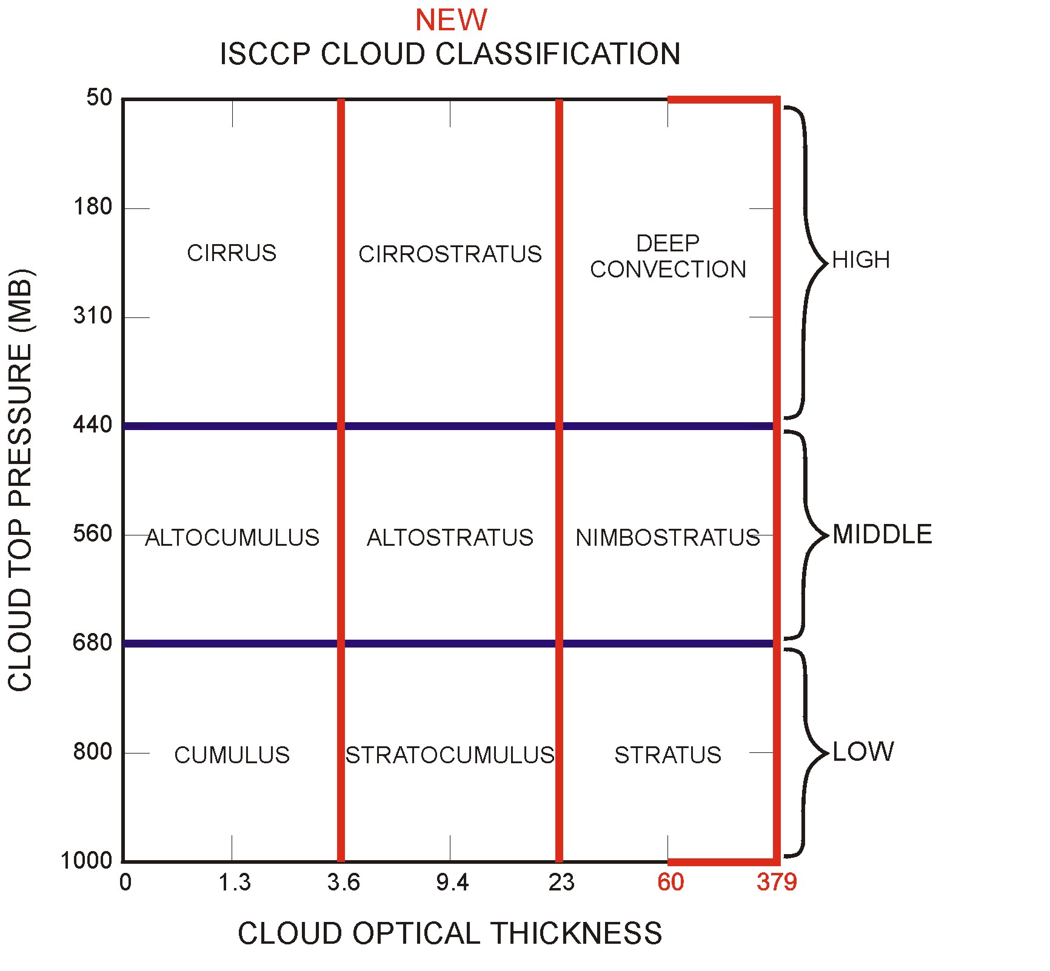
deep
convection
cirrus
cirrostratus
altocumulus
altostratus
nimbostratus
cumulus
stratocumulus
stratus

Slide 19
Cloud Detection Principle
- Using atmospheric window regions, colder for clouds
Brightness Temperature for US std
0% cloud
40% cloud
60% cloud
wavenumber cm⁻¹

Slide 20
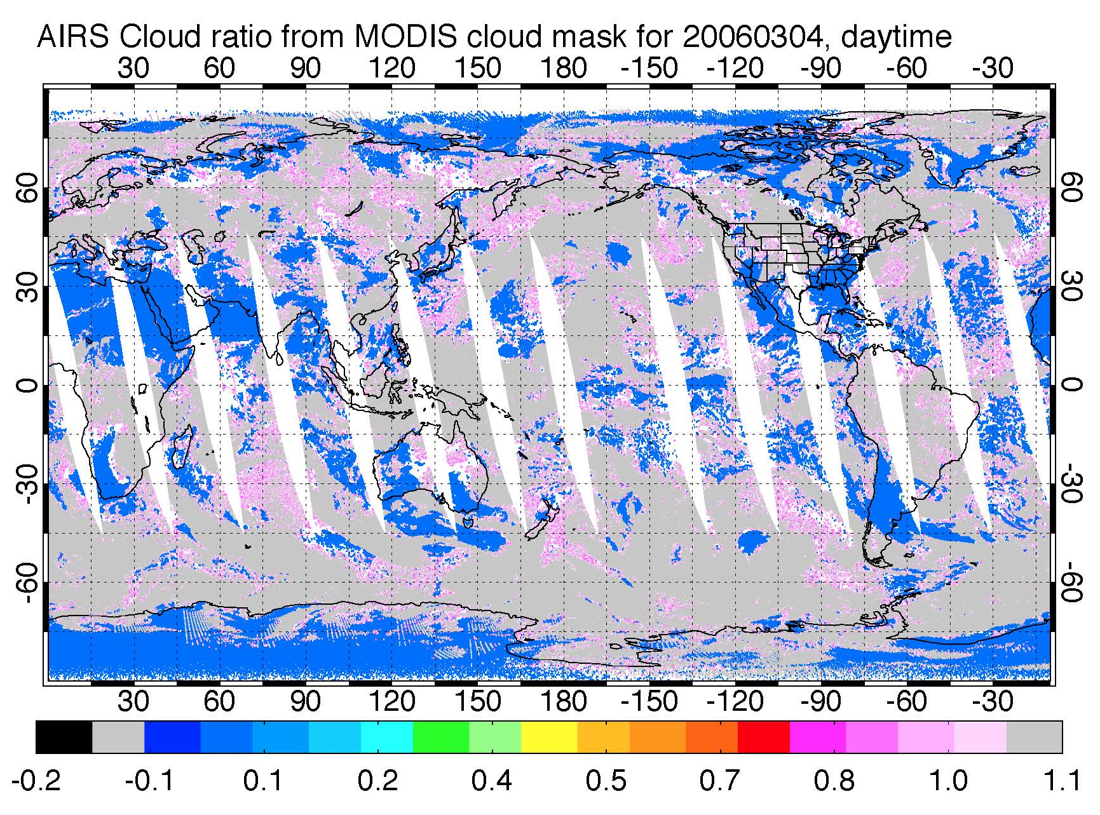
Treatment of clouds
- Cloud Clearing
Derive the clear column radiances that would have been there if there were no clouds
Assuming the two scenes only differ by the cloud coverage.
Works for broken or transparent clouds
Improve coverage from ~15% to 50-70%!
R_{obs} = αR_{cld} +(1-α)R_{clr}
N* Ξ α₁/α₂ = (R₁ - R_{clr})/(R₂ - R_{clr})
R_{clr} = (R₁ - N* R₂)/(1 - N*)
McMillin, L.M. and C. Dean 1982. Evaluation of a new operational technique for producing clear radiances. J. Appl. Meteor. 21 p.1005-1014.
Smith, W.L. 1968. An improved method for calculating tropospheric temperature and moisture from satellite radiometer measurements. Monthly Weather Review 96 p.387-396.
Notes:
Spectral plots – check email to find UMBC talk.
20

Slide 21
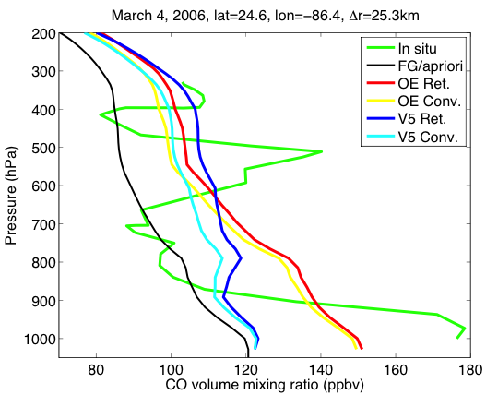
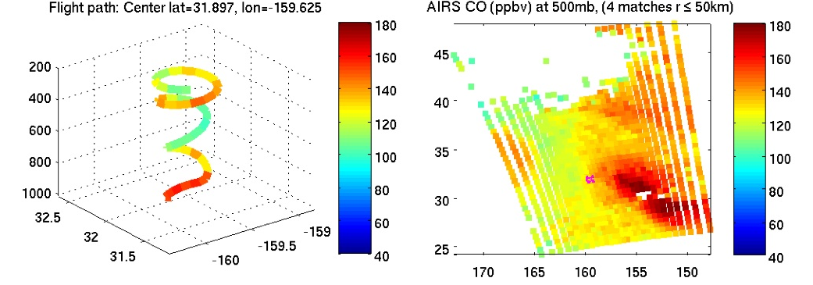
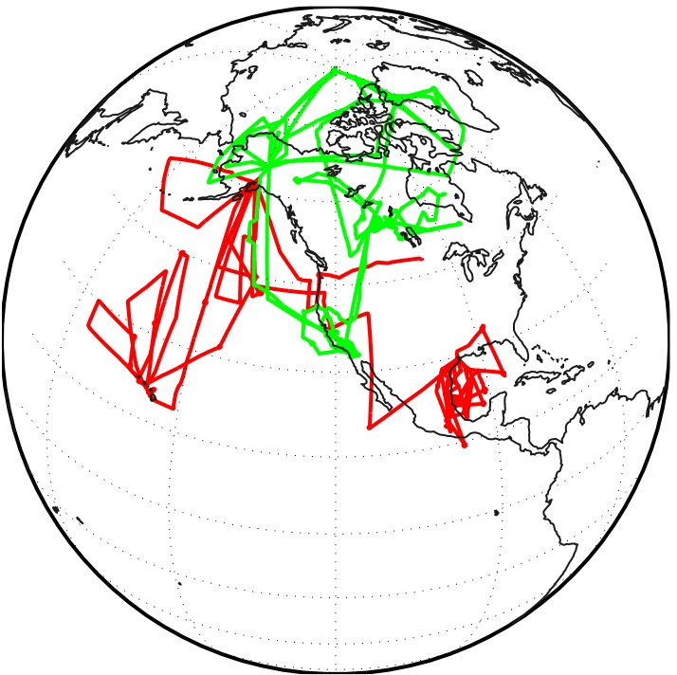
Validation
INTEX-B DC-8 spiral profiles on Mar. 4, 2006, over west of Birmingham, AL near the fires, with AIRS V5 CO (blue and cyan lines) and AIRS OE CO (red and orange lines).

Slide 22
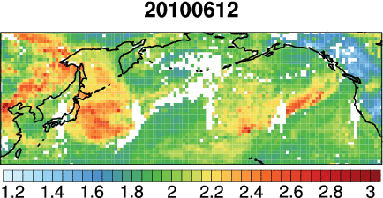
Transpacific Asian pollution plumes: the view from AIRS CO
Daily AIRS CO columns from June 12 to 21, 2010
[10¹⁸ molecules cm⁻²]
Lin, M., et al.: (2012a): Transport of Asian ozone pollution into surface air over the western United States in spring, Journal of Geophysical Research,117, D00V07, doi:10.1029/2011JD016961
Notes:
Connection in temporal evolution

Slide 23
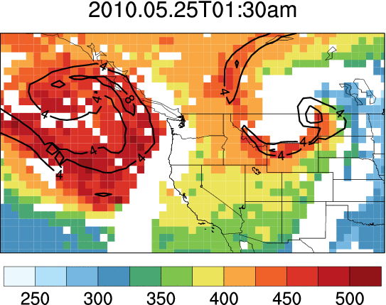
AIRS O₃ retrievals capture upper dynamics conducive to deep stratospheric intrusions over the western U.S.
AIRS O₃, May 25-29, 2010
Contours: 300 hPa PV from FNL analysis
Total column O₃ [DU]
Lin M et al. (2012b): Springtime high surface ozone events over the western United States: Quantifying the role of stratospheric intrusions, Journal of Geophysical Research, 117, D00V22, doi:10.1029/2012JD018151
Notes:
Connection in temporal evolution

Slide 24
15-year Carbon Monoxide Movie
- AIRS Daily Global
http://www.aosc.umd.edu/~juying

Slide 25
AIRS V5 and NOAA IASI at 500 hPa CO trends
recent emission (right Gaussian: red-AIRS and yellow-IASI) and
background (left Gaussian: blue-AIRS and cyan-IASI)
Worden, H. M., Deeter, M. N., Frankenberg, C., George, M., Nichitiu, F., Worden, J., Aben, I., Bowman, K., Clerbaux, C., Coheur, P.F., de Laat, A.T., Detweiler, J. R., Drummond, J.R., Edwards, D., Gille, J., Hurtmans, D., Luo, M., Martínez-Alonso, S., Massie1, S., Pfister1, G., Sweeney, C., Warner, J.X., 2013, Decadal Record of Satellite Carbon Monoxide Observations, Atmos. Chem. Phys., 13, 837-850, doi:10.5194/acp-13-837-2013.
He, H., Stehr, J. W., Hains, J. C., Krask, D. J., Doddridge, B. G., Vinnikov, K. Y., Canty, T. P., Hosley, K. M., Salawitch, R. J., Worden, H. M., and Dickerson, R. R. (2013), Trends in emissions and concentrations of air pollutants in the lower troposphere in the Baltimore/Washington airshed from 1997 to 2011, Atmos. Chem. Phys., 13, 7859-7874, doi:10.5194/acpd-13-3135-2013.
Warner, J., Carminati, F., Wei, Z., Lahoz, W., and Attié, J.-L.: Tropospheric carbon monoxide variability from AIRS under clear and cloudy conditions, Atmos. Chem. Phys., 13, 12469-12479, doi:10.5194/acp-13-12469-2013, 2013.

Slide 26
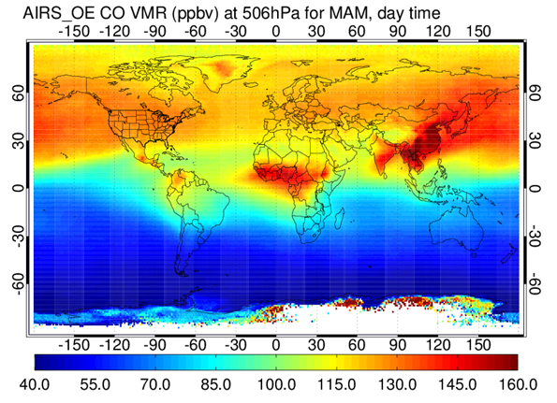
Recent emission from AIRS
Compared with standard emission inventories

Slide 27
Implications of separating fresh emissions from the background

Slide 28
Ammonia (NH₃) Distributions and Recent Trends by 14-year AIRS Measurements
J. X. Warner¹, Z. Wei¹, R. R. Dickerson¹, L. L. Strow², J. B. Nowak³
Y. Wang⁴, Q. Liang^{5, 6}
¹ Dept. of Atmospheric and Oceanic Science, UMCP, College Park, MD, U.S.A.
² Dept. of Physics and JCET, UMBC, Baltimore, MD, U.S.A.
³ Aerodyne Research, INC
⁴ Department of Earth and Atmospheric Sciences, University of Houston
⁵ NASA Goddard Space Flight Center, Atmospheric Chemistry and Dynamics, Greenbelt, MD, U.S.A.
⁶ Universities Space Research Association, GESTAR, Columbia, MD, U.S.A.
* Published in ACP: The Global Tropospheric Ammonia Distribution as seen in the 13-year
AIRS Measurement Record
* Published in GRL: Increased Atmospheric Ammonia over the World’s Major Agricultural Areas Detected from Space
* Funded by NASA’s The Science of Terra and Aqua Program (NNX11AG39G), the
Atmospheric Composition Program (NNX07AM45G), and SCIS (NNX16AQ67G).

Slide 29
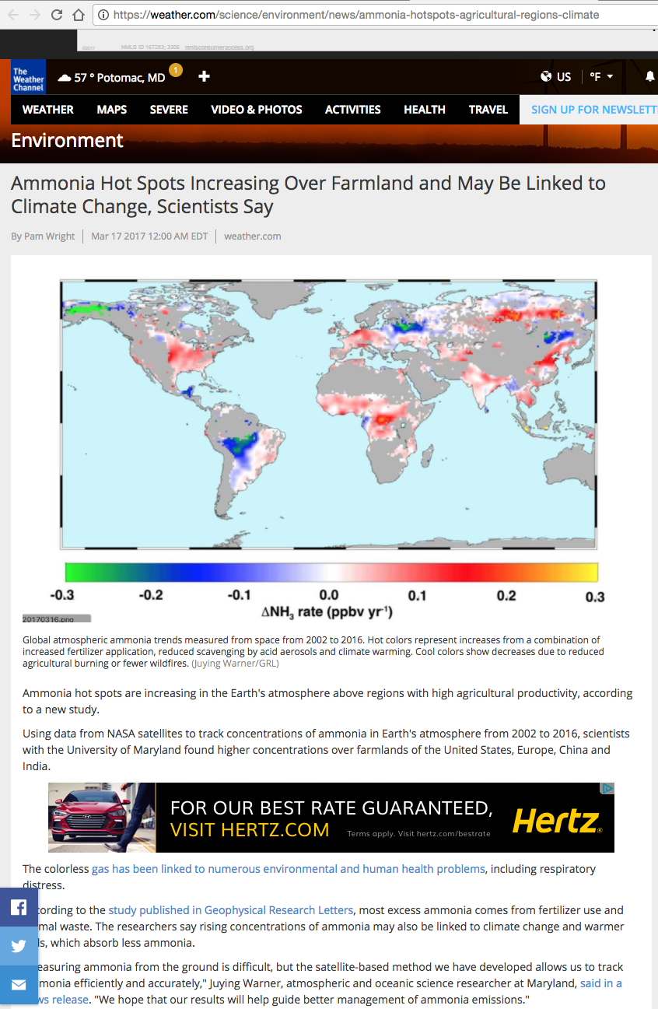
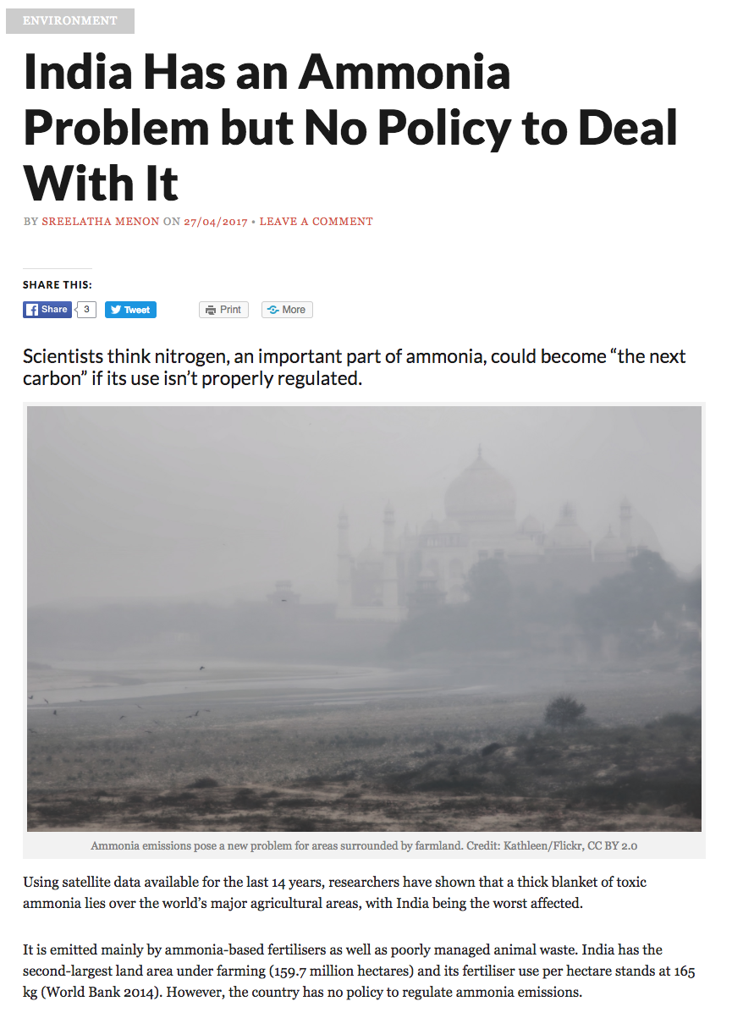

Slide 30
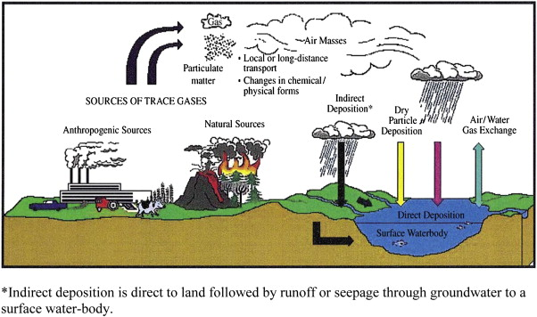
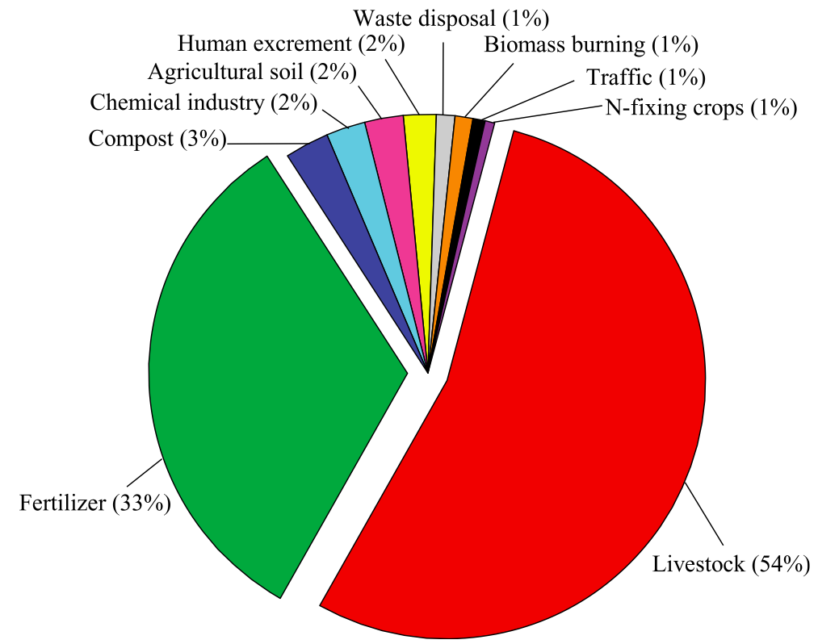
Why Ammonia (NH₃)
- affect air quality, ecosystem, and climate, primarily from anthropogenic sources
Aneja et al., 2012
Sources:
Fertilizer use for crop production;
Anima feeding operations;
Emission increase with:
  Nitrogen storage and pH of soils;
  Surface temperature exponentially;
  Soil moisture, etc.
Biomass burning and volcanoes.
Sinks:
Dry and wet deposition (soil acidification and eutrophication);
Convert to particulate ammonium by reacting with sulfuric and nitric acids, arising from SO₂ and NO_{x}.
Fertilizer (33%)
Livestock (54%)
Huang et al., GBC, 2012

Slide 31
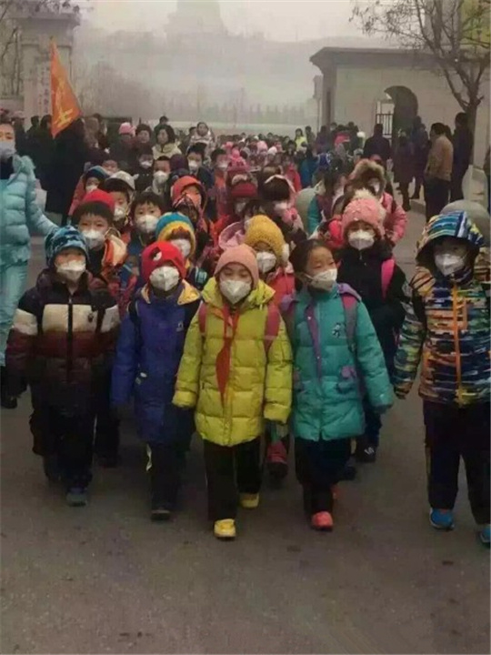
Ammonia - precursor gas of PM_{2.5}
Precursor gases for PM_{2.5}
  (by secondary inorganic aerosols - a large portion of PM_{2.5}):
  Sulfer dioxide (SO₂);
  Nitrogen oxides (NO_{x});
  Ammonic (NH₃);
Only NH₃ is not regulated;
Ammonia is the limiting species in PM_{2.5} formation, regulating SO₂ and NO_{x} alone cannot determine the fate of PM_{2.5};
Meteorological conditions (wind, rain, temperatures, etc.) affects the concentration of ammonia gases.

Slide 32
Why Satellite Remote Sensing
  Ammonia in situ measurements are rare, global coverage is impossible.
Satellite measurements with daily and large global coverage are challenging and have been lacking partly because the lifetime of NH₃ is relatively short and partly because it requires high sensitivity for the retrievals that can be only obtained from areas with high thermal contrasts near the surface (Clarisse et al., 2010).
AIRS (Atmospheric InfraRed Sounder) afternoon overpasses (1:30pm) are best correlated with the daily emission peak time and during the daily period with the highest thermal contrast. Additionally, AIRS large coverage with wide swaths and cloud-clearing provide daily NH₃ maps. The 13-year data records makes AIRS the best sensor for NH₃ trends and variability studies (to date).

Slide 33
Atmospheric InfraRed Sounder (AIRS)
Launched May 2002; afternoon (1:30pm) overpass; daily global coverage
A grating spectrometer originally designed to improve weather forecast and now also used for climate and air quality studies.
Spectral resolution at 1/1200 (~ 0.5 cm⁻¹)
Covers 650-2665 in three bands with a total of 2378 channels
Spatial resolution 13.5 km² (with retrievals at ~45 km²)
Wide swaths and cloud clearing provide daily global coverage
Very high Signal-to-Noise accuracies of 1K over 1 km-layer.
AQUA
AMSU
AMSR-E
HSB
MODIS
AIRS
CERES
Notes:
33

Slide 34
AIRS NH₃ Algorithm
Globally one set a priori (GEOS-chem). Variation in the retrievals are from measurements.
Select a priori levels based on brightness temperature differences
Notes:
AIRS NH3 retrievals use Optimal Estimation (OE) technique (Rodgers, 2000);
CCRs and SARTA are used as in AIRS algorithm for other species;

Slide 35
Validation vs CRDS/Picarro in DISCOVER-AQ CA CRDS/Picarro Spiral Profiles Only - 01/16 to 02/06, 2013
(data courtesy of Co-author J. Nowak)
Gray – a priori; Red – retrievals; Green solid – in situ; and Green dashed – convolved in situ.
AIRS L2 pixel sizes are ~45 km², can coincide with multiple in situ profiles.
AIRS NH₃ measurements are most sensitive at 850-950 hPa layer.

Slide 36
Global NH₃ in 2002-2015
NH₃ VMRs (ppbv)
At 918 hPa
High concentrations are mainly due to human activities and fires;
Sources are seen in valleys (e.g., San Joaquin Valley, California in the U.S., the Po Valley, Italy, Fergana Valley, Uzbekistan, and the Sichuan Basin in China); Agricultural especially in irrigated lands (e.g., Azerbaijan, Nile Delta and near Nile River in Egypt, the Mid-West U.S., in the Netherlands, in Mozambique and Ethiopia, Africa, and especially the Indo-Gangetic Plain of South Asia).

Slide 37
Global Frequent Occurrences in 2002-2015
Frequent Occurrences:
For NH₃ >=1 ppbv
Use occurrences of higher emissions (lower) to distinguish between the two major sources: agricultural (high VMRs & high frequencies); BB emissions (high VMRs & low frequencies).

Slide 38
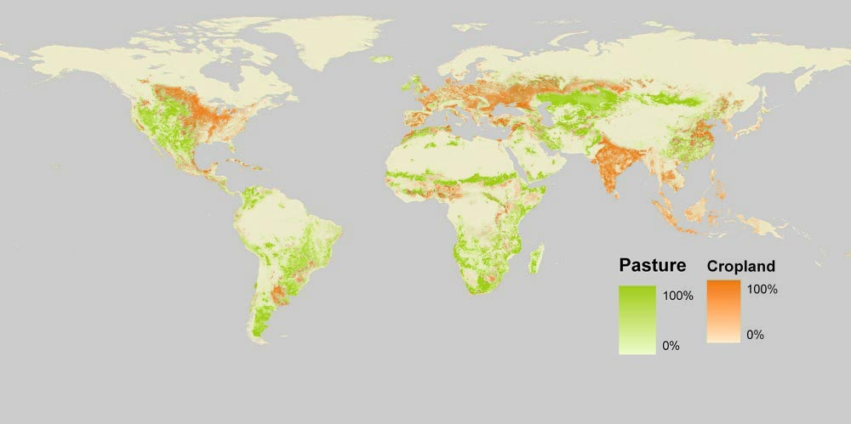
Top panel: The NH₃ VMRs from the persistent sources, i.e., ≥ 1.4 ppbv for more than 40 days;
Bottom panel: Pasture and Cropland Map (http://OurWorldInData.org)

Slide 39
NH₃ Trends - Last 14 years
Global trends in atmospheric NH₃ (i.e., VMRs at 918hPa for each 1x1 grid)
Red-yellow colors represent increases due to agriculture emission increases and reduced scavenging by acid aerosols
Blue-green colors represent decreases due to possibly reduced agricultural burning and fewer wild fires

Slide 40
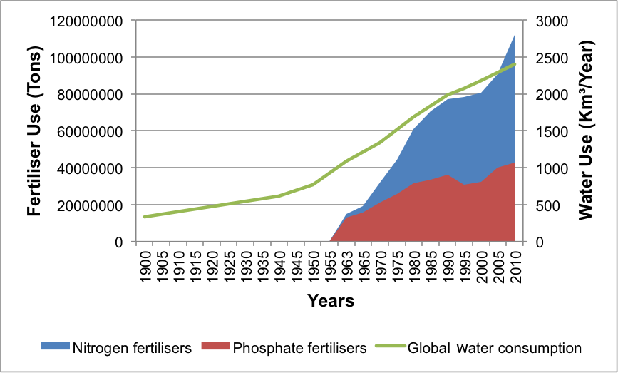
NH₃ Increase – Fertilizer Applications
Country /Region | Mean fertilizer use (TgN yr⁻¹) [trend] 2002-2013
US | 11.5 [+0.7% yr⁻¹]
EU | 11.0 [−0.3% yr⁻¹]
China | 31.2 [+2.7% yr⁻¹]
S. Asia | 18.8 [+3.6% yr⁻¹]
http://data.worldbank.org/indicator/AG.CON.FERT.ZS
http://www.ars.usda.gov/Services/docs.htm?docid=18349
Courtesy of Russ Dickerson
http://sedac.ciesin.columbia.edu/
https://freshwaterwatch.thewaterhub.org/

Slide 41
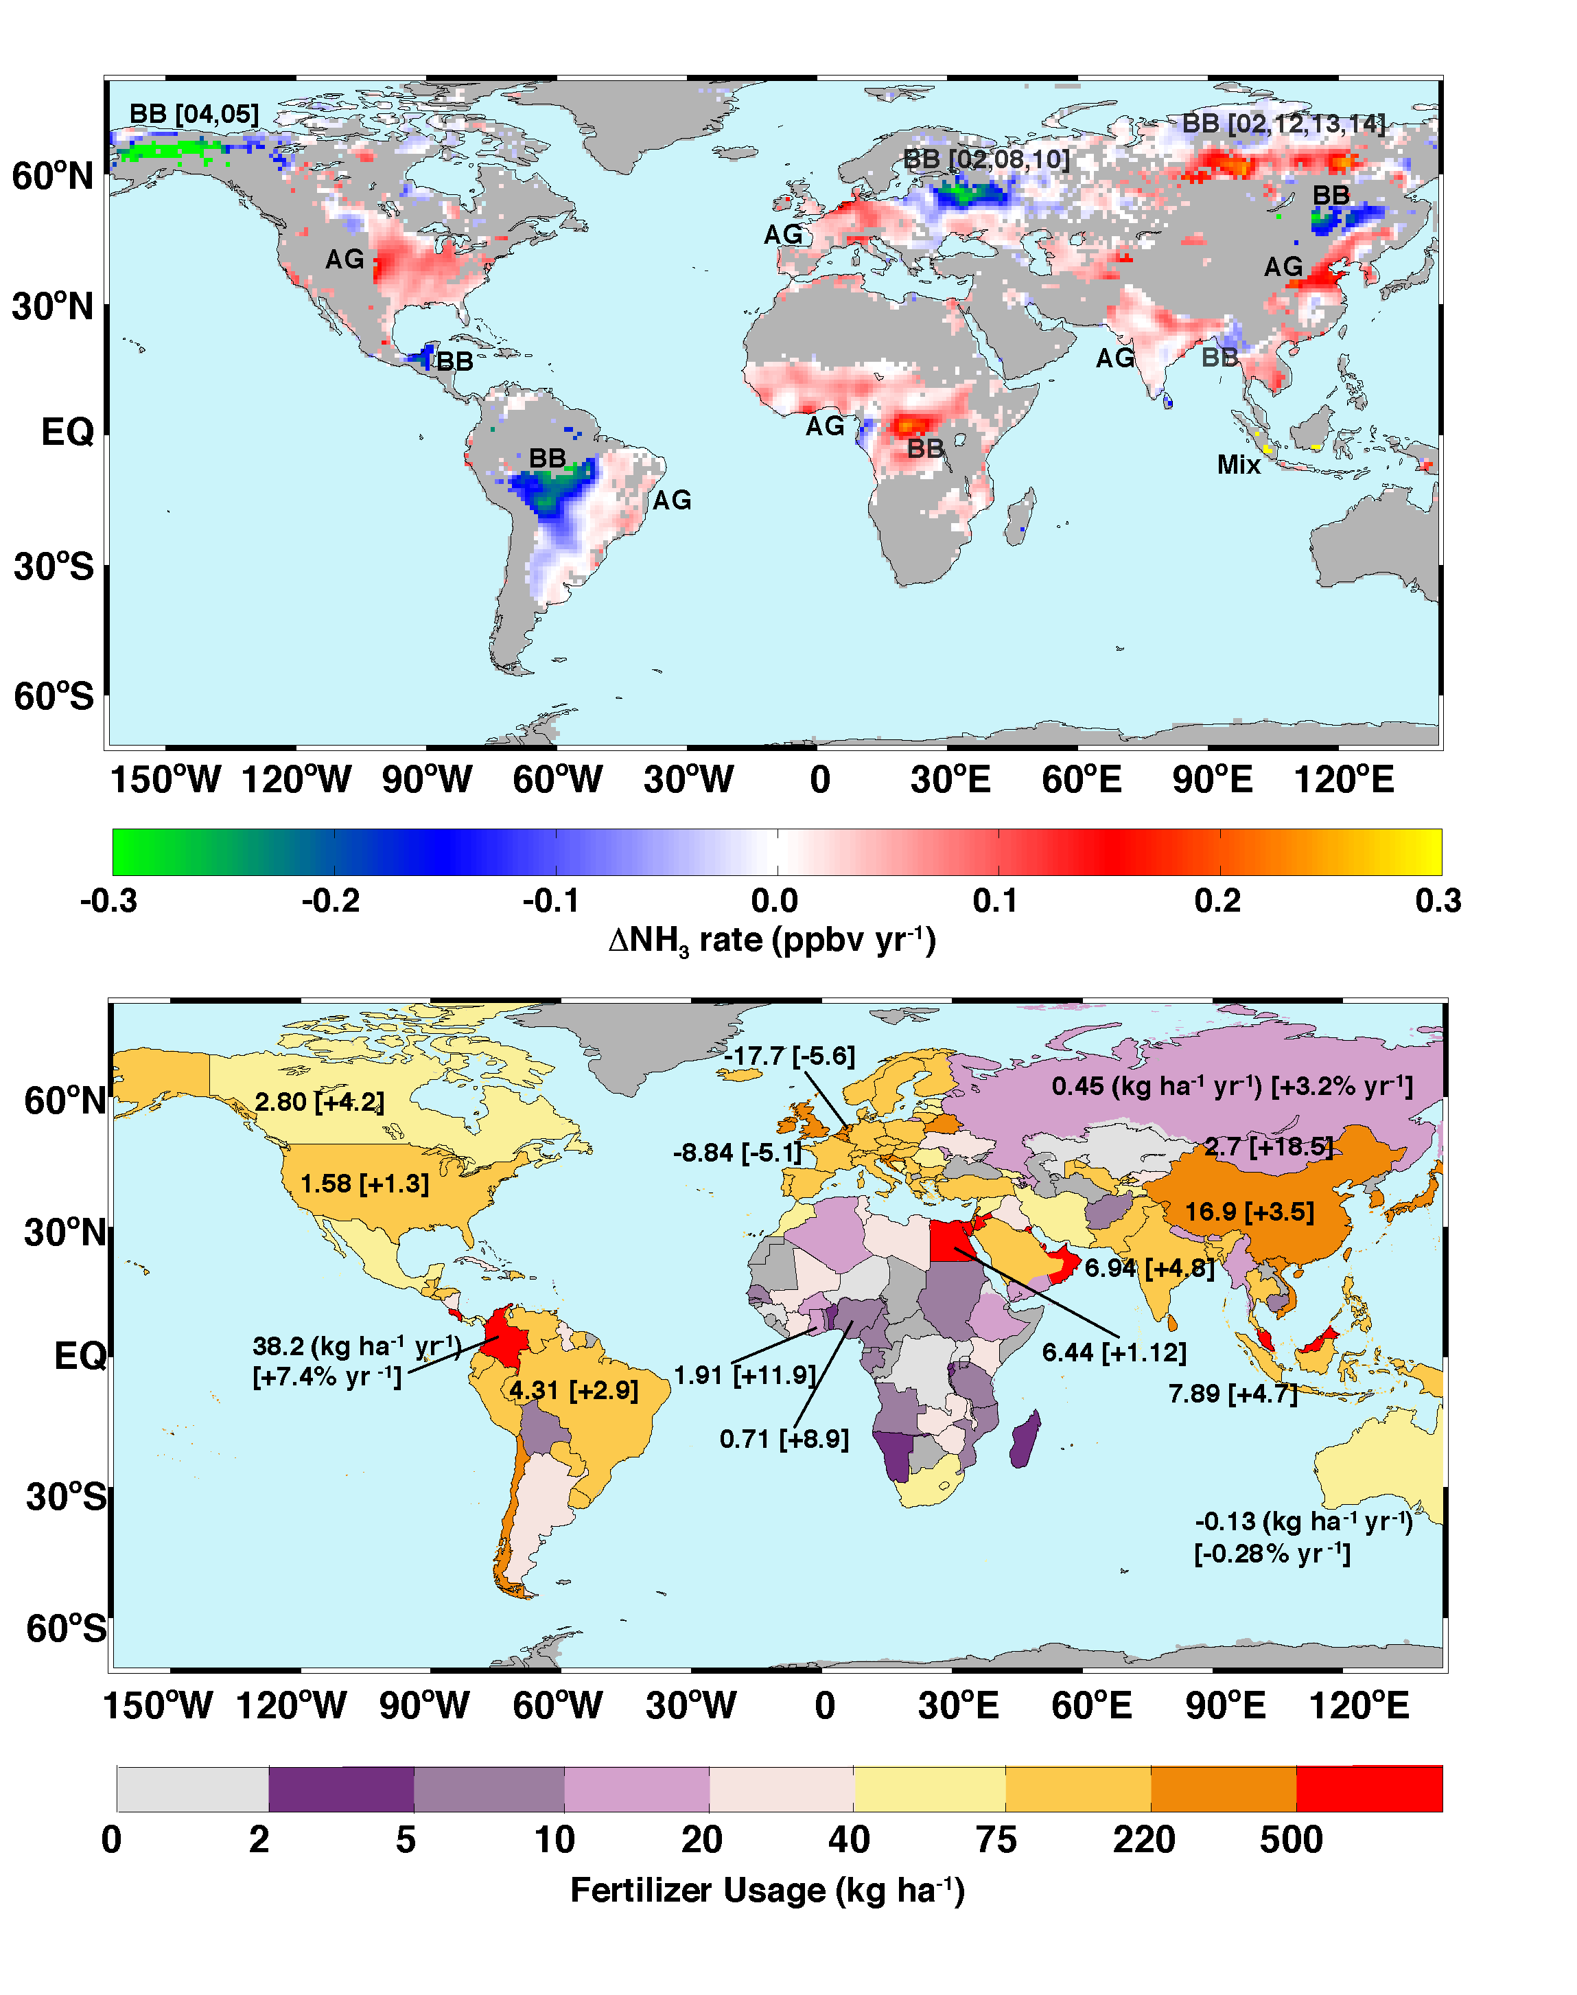
(top) Temporal trends; BB-biomass burning and AG- agricultural regions
(bottom) National averaged annual N fertilizer usage in 2002–2013 in kg ha⁻¹ and trends (percentage changes)

Slide 42
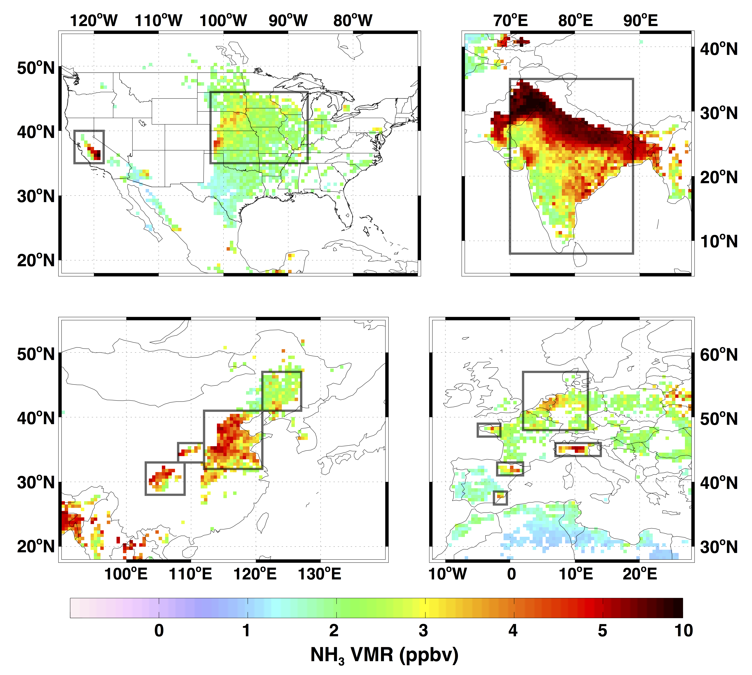
NH₃ over USA, China, India, and Europe
Using high concentration and high frequencies
Notes:
Black boxes are regions used for follow up trend studies.

Slide 43
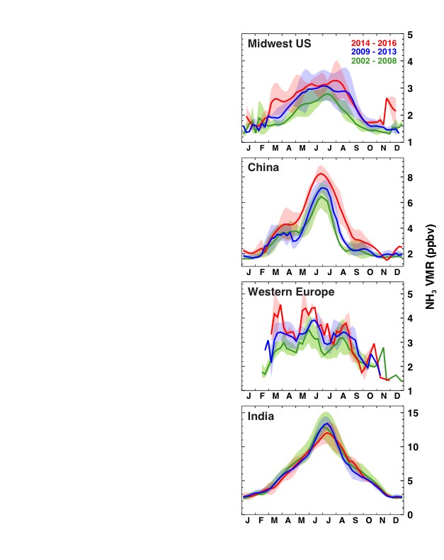
AIRS NH₃ Seasonal Variation
- over USA, China, Europe, and S. Asia
The highest NH₃ concentrations in average occur in South Asia, and China. Note scales.
NH₃ in India seasonal variation are broad and no obvious increasing/decreasing trends;
NH₃ for USA, China and Europe have increased, with peaks in both spring and summer;

Slide 44
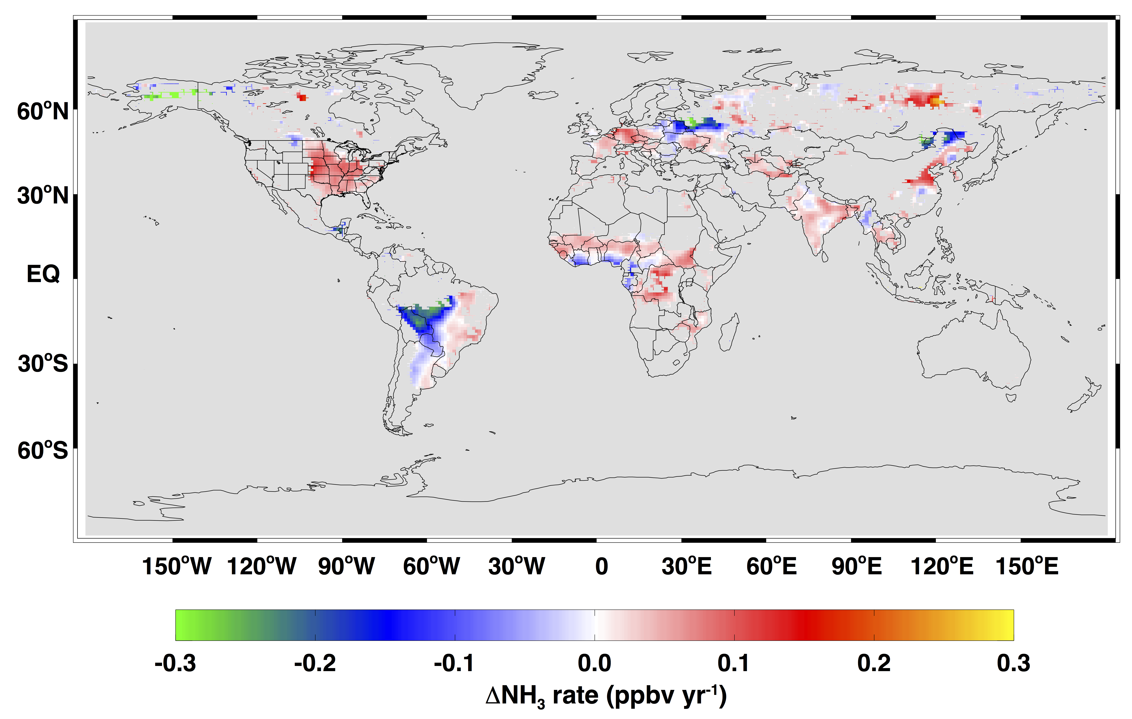
AIRS NH₃ Trends vs OMI SO₂ and NO₂ Trends
NH₃
USA
NH₃
China
NH₃
S. Asia
NH₃
W. Europe

Slide 45
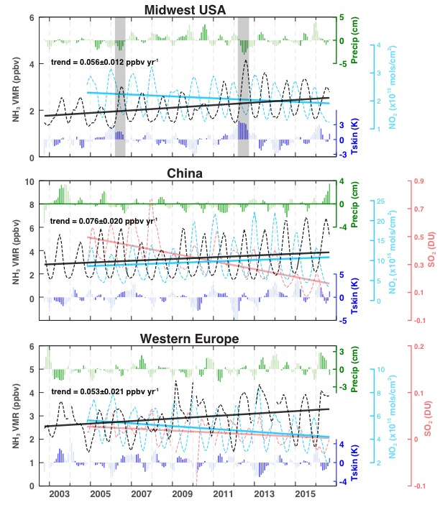
AIRS NH₃ vs OMI NO₂ for US (top), SO₂ for China (middle) and NO₂ for Western Europe (lower)
All show increasing NH₃ trends (black) 2002-2016.
Decreased SO₂ largely explains the NH₃ increases in Midwest U.S. (not shown), China, and Europe.
OMI NO₂ decreasing explains winter NH₃ increasing over the US and Europe.
Meteorological conditions also affect NH₃ concentrations (high surface temperatures and low precipitation), see shaded anomalies in the top panel.
ECMWF surface skin temperatures show increases over the US and China can possibly link climate change to the increased NH₃ emissions.

Slide 46


South Asia Aerosols Trends
2003-2007
2008-2014
No obvious NH₃ increased in the AIRS observations over South Asia, while the fertilizer usage has increased;
Recent increases in SO₂ and NO_{x} from uncontrolled coal combustion and other sources;
Greater conversion of gaseous NH₃ into particulate sulfates and nitrates.
Dust influence in premonsoon and sea salt during monsoon, more fine mode aerosols in postmonsoon.
Postmonsoon
Aerosol Optical Depth at 550 nm
Premonsoon
Postmonsoon
Courtesy of NASA MODIS team
Notes:
This region is bordered by the Himalayas to the north, Vindhyan Satpura ranges to the south, Thar desert and the Arabian Sea in the west and the Bay of Bengal in the east. Less influence from dust in postmonsoon and sea salt during monsoon, more fine mode aerosols.

