Slide 1
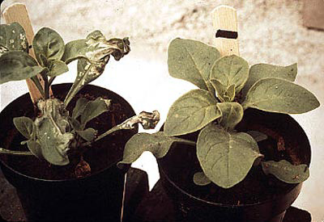
AOSC 637
Tropospheric Ozone
Ozone is a major pollutant. It does billions of dollars worth of damage to agricultural crops each year and is the principal culprit in photochemical smog. Ozone, however, exists throughout the troposphere and, as a major OH source and a greenhouse gas, plays a central role in many biogeochemical cycles. That photochemical processes produce and destroy stratospheric ozone have been recognized since the thirties, but the importance of photochemistry in tropospheric ozone went unrecognized until the seventies.

Slide 2
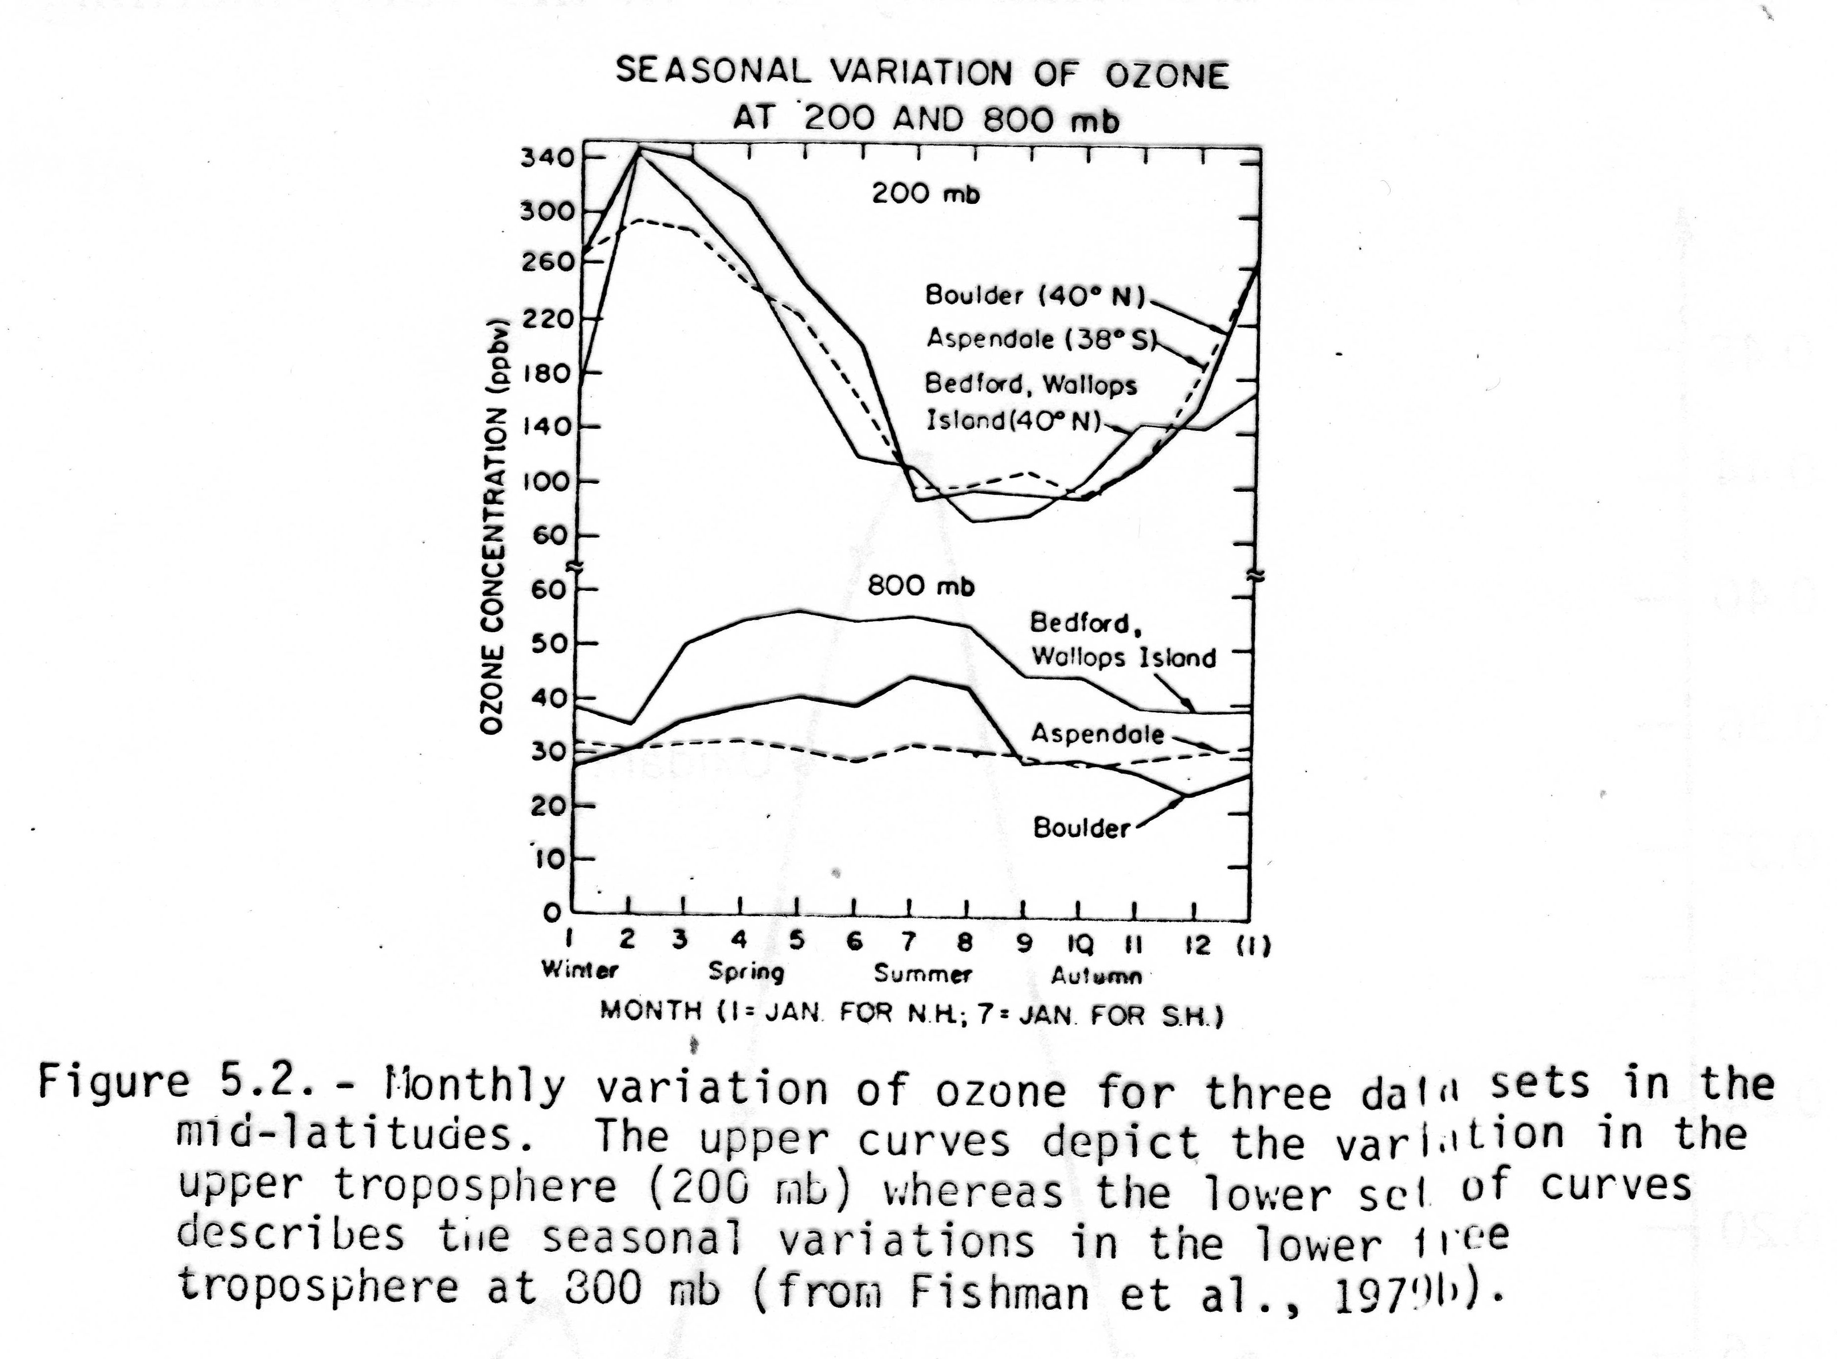
The classical view of tropospheric ozone was provided by Junge (Tellus, 1962) who looked at all the available ozone observations from a handful of stations scattered over the globe. Free tropospheric concentrations appeared to be fairly uniform, but boundary layer concentrations were reduced. He also noticed a repeating annual cycle with spring maxima and fall minima. Tropospheric ozone maxima lagged stratospheric maxima by about two months. From this he concluded that ozone is transported from the stratosphere into the troposphere where it is an essentially inert species, until it contacts the ground and is destroyed. The implied residence time varies from 0.6 to 6.0 months.
Source – Stratosphere
Sink – Surface deposition
Chemistry – Little or none
Lifetime 0.6 to 6.0 mo

Slide 3
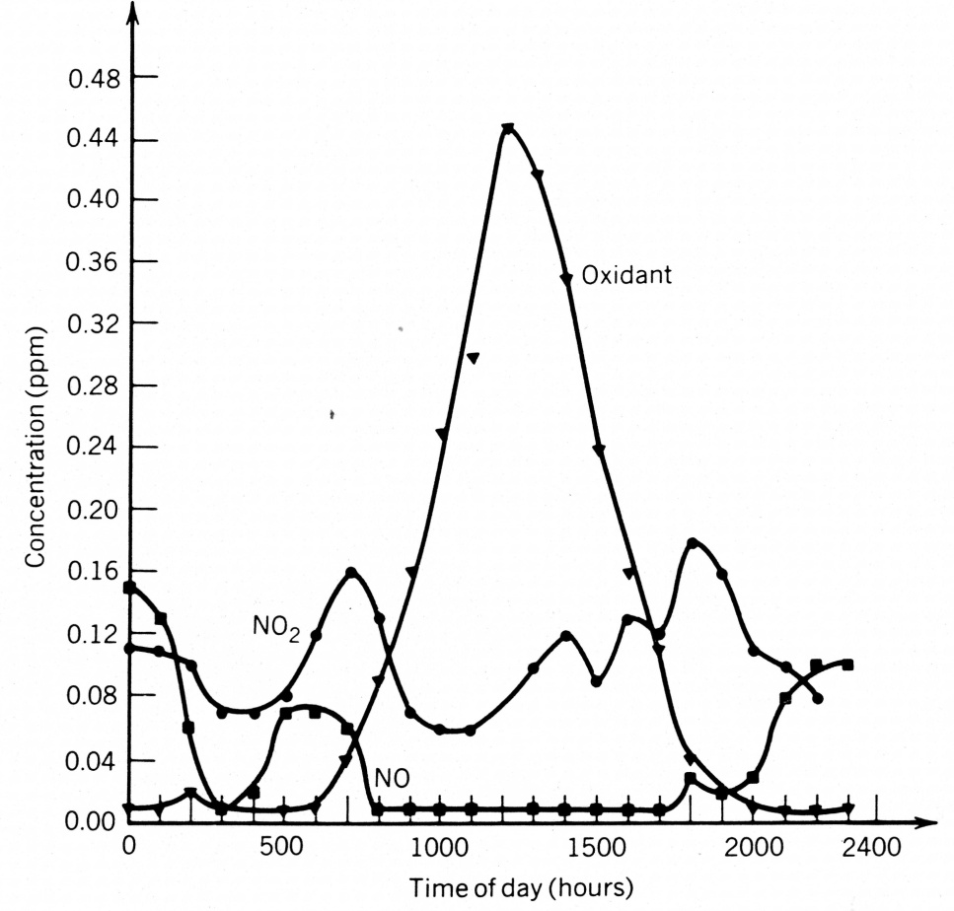
Levy (Planet. Space Sci., 1972) first suggested that radicals could influence the chemistry of the troposphere, and Crutzen (Pageoph, 1973), shortly followed by Chameides and Walker (J. Geophys. Res., 1973), pointed out that these radical reactions could form ozone in the nonurban troposphere. Chameides and Walker’s model predicted that the oxidation of methane (alone) in the presence of NOx would account for all the ozone in the troposphere and that ozone has a lifetime of about 1 day. Chatfield and Harrison (J. Geophys. Res., 1976) countered with data that show the diurnal variation of ozone in unpolluted sites is inconsistent with a purely photochemical production mechanism and showed that meteorological arguments could explain most of the observed ozone trends described by Chameides and Walker.
Radical View
Source – CH₄ + NOx + hν
Sink – Surface and rxn with HOx
Lifetime – 1 d
Image from Pasadena, CA 1973
(Finlayson-Pitts and Pitts, 1977).

Slide 4
To summarize, chemists found a possible major anthropogenic perturbation of a vital natural process. In their zeal to explain this problem some of the chemists completely neglected the physics of the atmosphere. This irritated some meteorologists, who point out that one can equally well interpret the observations in a purely meteorological context. With the dust settled, we can see that the physics of the atmosphere controls the day-to-day variations and the general spatial structure, but chemistry can perturb the natural state and cause long term trends. This paradigm recurs.

Slide 5
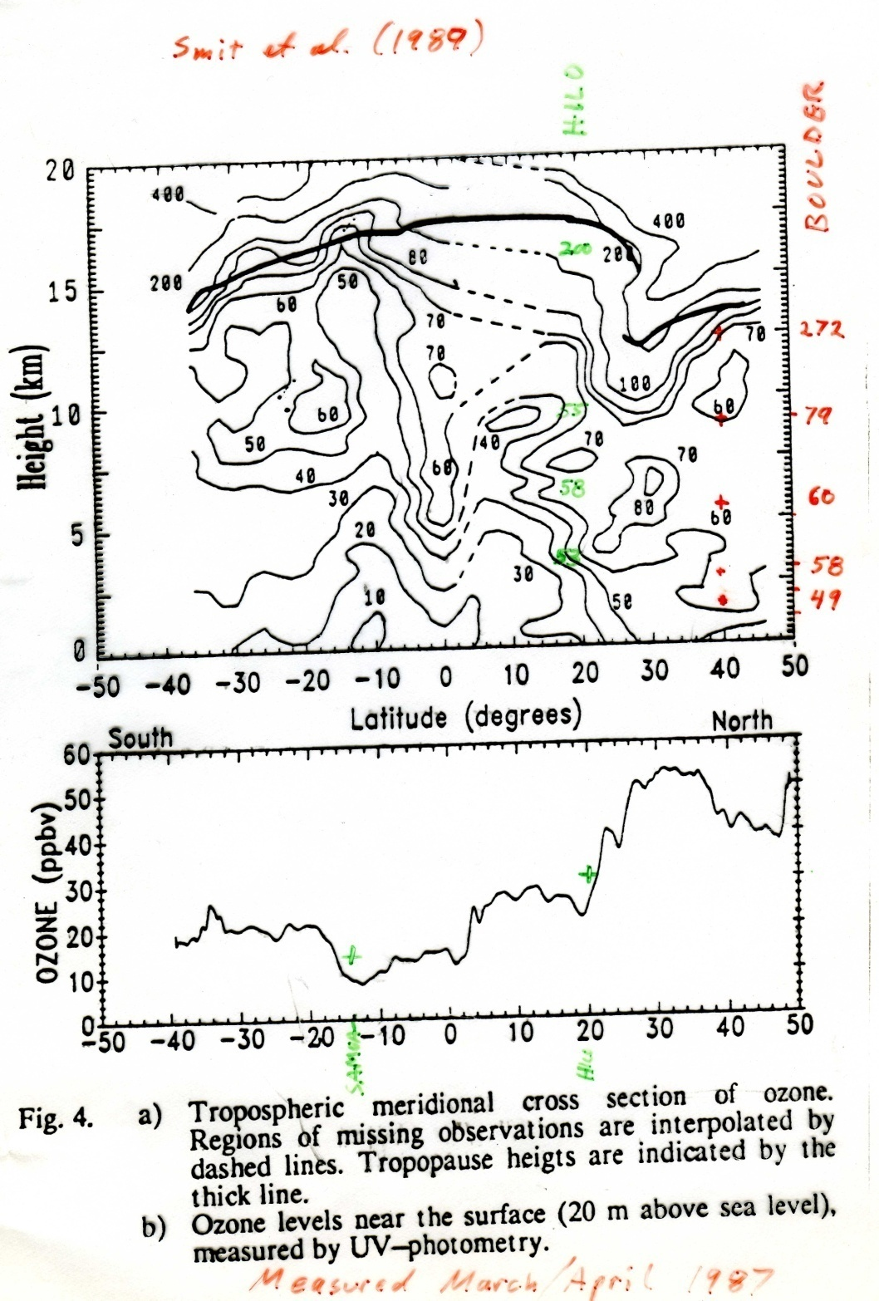

Slide 6
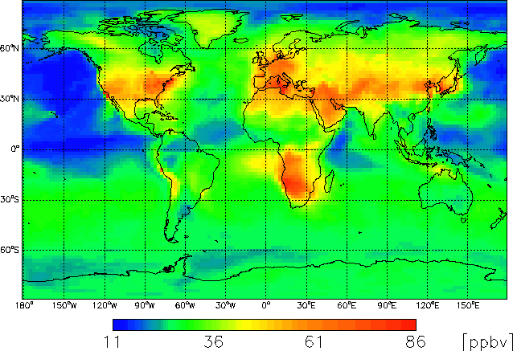
Monthly mean afternoon (1 to 4 PM) surface ozone concentrations calculated for July using Harvard GEOS-CHEM model.

Slide 7
What was the ozone concentration in the pre-industrial atmosphere?
Volz and Kley Nature (1988)
  In the 19th century, Albert-Levy bubbled air through a solution of iodide and arsenite
  2I⁻ + O₃ + AsO₃³⁻ → O₂ + AsO₄³⁻ + I₂
  To measure the amount of iodine produced by ozone they titrated with iodine solution and starch as an indicator.

Slide 8
The absolute value is now much higher, even in rural areas near France; Arkona is an island in the Baltic.
The seasonal cycle has shifted toward summer.
Volz and Kley attributed this to increased NOx emissions.

Slide 9
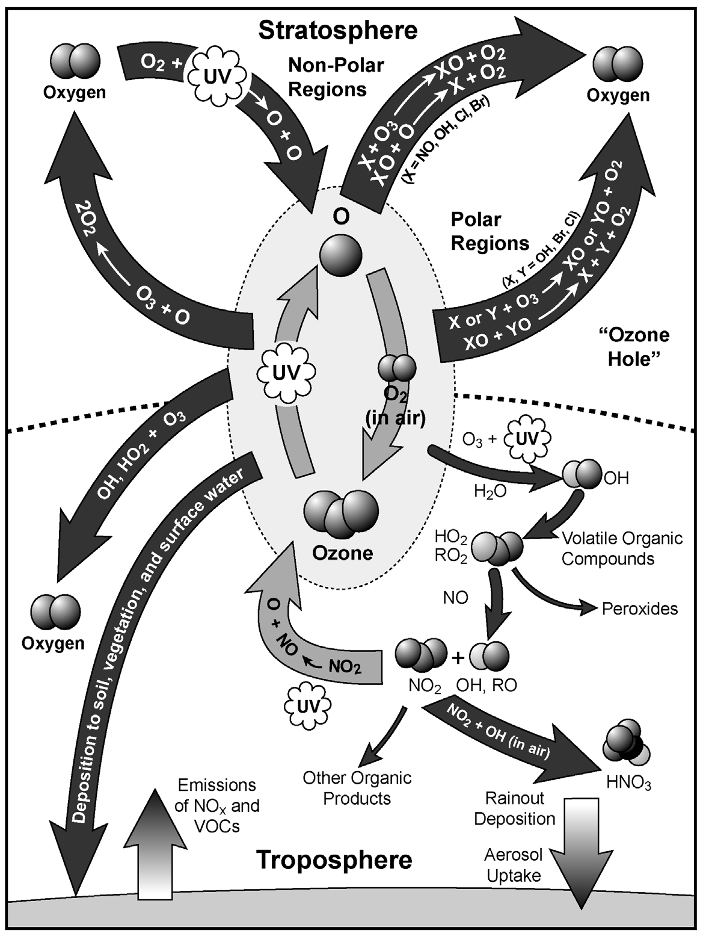
Schematic overview of O₃ photochemistry in the stratosphere
and troposphere.
From the EPA Criteria Document for Ozone and Related Photochemical Oxidants, 2007.

Slide 10
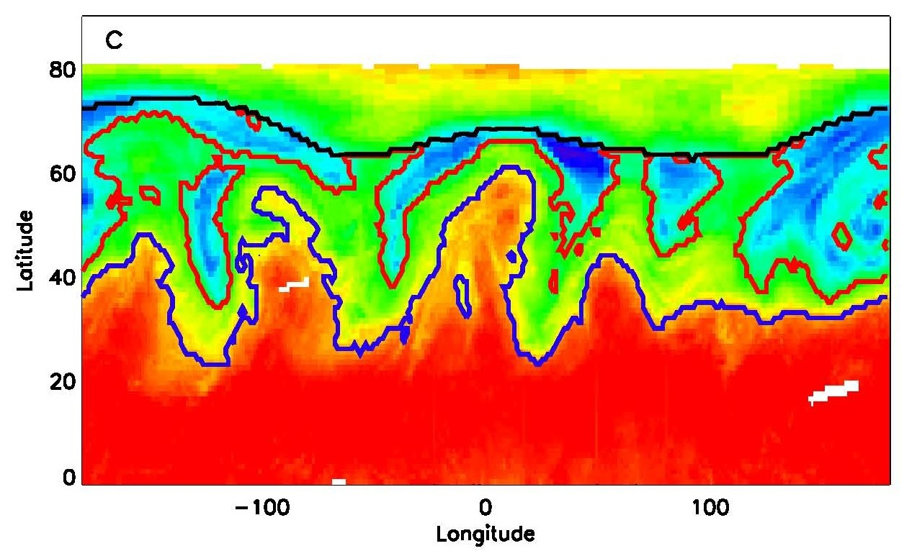
Jet Streams on March 11, 1990
Hotter colors mean less column ozone.

Slide 11
TROPOSPHERIC Ozone Photochemistry
CLEAN AIR
(1) O₃ + hν → O₂ + O(¹D)
(2) O(¹D) + H₂O → 2OH
(3) OH + O₃ → HO₂ + O₂
(4) HO₂ + O₃ → 2O₂ + OH
-----------------------------------------
(3+4) 2O₃ → 3O₂ NET
11

Slide 12
DIRTY AIR
(3') OH + CO → H + CO₂
(4') H + O₂ + M → HO₂ + M
(5') HO₂ + NO → NO₂ + OH
(6') NO₂ + hν → NO + O
(7') O + O₂ + M → O₃ + M
-------------------------------------------------
(3'-7') CO + 2 O₂ → CO₂ + O₃ NET
12

Slide 13
SIMILAR REACTION SEQUENCE FOR METHANE
CH₄ + OH→ CH₃ + H₂O
CH₃ + O₂ + M→ CH₃O₂ + M
CH₃O₂ + NO→ NO₂ + CH₃O
CH₃O + O₂ → H₂CO + HO₂
HO₂ + NO→ NO₂ + OH
NO₂ + hν → NO + O
O + O₂ + M→ O₃ + M
−−−−−−−−−−−−−−−−−−−−−−−−−−−−−−−−
CH₄ + 4O₂ + hν → 2O₃ + H₂CO + H₂O NET

Slide 14
What is the fate of formaldehyde?
2H₂CO + hν → H₂ + CO
→ HCO + H
H + O₂ + M→ HO₂ + M
HCO + O₂ → HO₂ + CO
−−−−−−−−−−−−−−−−−−−−−−−−−−−−−−
2H₂CO + 2O₂ → 2CO + 2HO₂ + H₂
The grand total is 4 O₃ per CH₄ oxidized!

Slide 15
What constitutes sufficient NO to make ozone photochemically?
HO₂ + O₃ → 2O₂ + OH (4)
HO₂ + NO → NO₂ + OH (5)
When R₄ = R₅ then k₄[O₃] = k₅[NO] and production matches loss.
This happens around [NO] = 10 ppt

Slide 16
Chain terminating steps:
NO₂ + OH + M → HNO₃ + M
HO₂ + HO₂ → H₂O₂ + O₂
These reactions remove radicals and stop the catalytic cycle of ozone production.
Definitions: NO_{x} = NO + NO₂
NO_{y} = NO_{x} + HNO₃, + HNO₂ + HO₂NO₂ + PAN + N₂O₅ + RONO₂ + NO₃⁻ + …
NO_{z} ≡ NO_{y} - NO_{x}

Slide 17
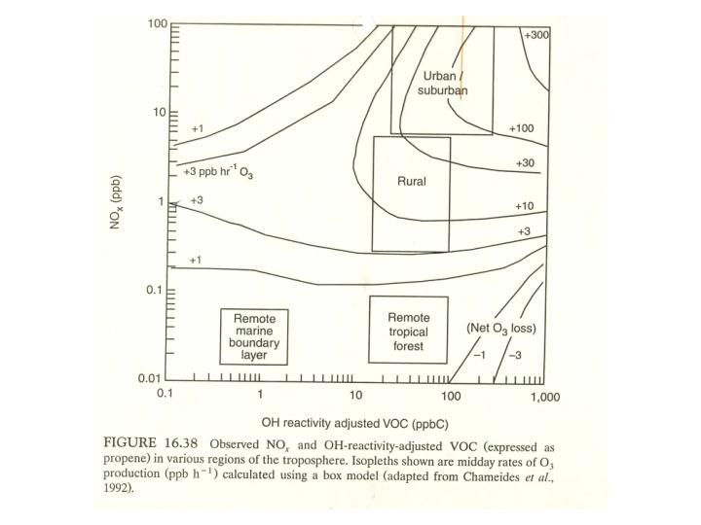
EKMA.
Empirical Kinetic Modeling Approach, or EKMA. See Finlayson & Pitts page 892.

Slide 18
American CO Emissions
185 Tg
140 Tg
70 Tg

Slide 19
American NOx Emissions
24 Tg as NO₂
23 Tg as NO₂
g(NO₂ ) ● 14/46 = g(N)
15 Tg as NO₂

Slide 20
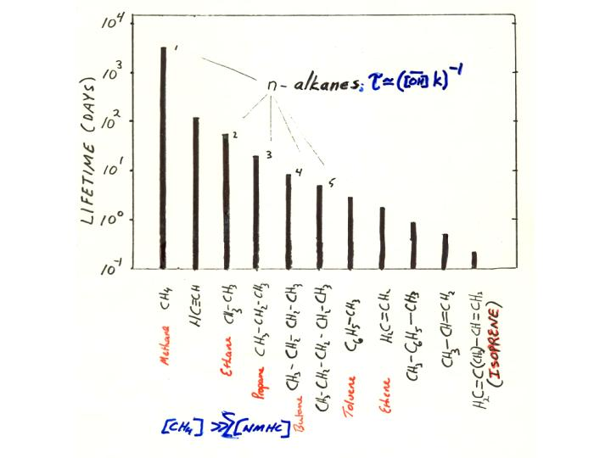
R-CH₃ + . OH → H₂O + RCH₂.
The lifetime of hydrocarbons with respect to OH attach decreases with chain length and with points of unsaturation. Electron donors stabilize reactive intermediates and radical products.

Slide 21
Criteria Pollutant Ozone, O₃
Secondary
Effects:
1. Respiration - premature aging of lungs (Bascom et al., 1996); mortality (e.g., Jerrett et al., 2009).
2. Phytotoxin, i.e. Vegetation damage (Heck et al., JAPCA., 1982;
Schmalwieser et al. 2003; MacKinzie and El-Ashry, 1988)
3. Materials damage - rubber
4. Greenhouse effect (9.6 μm)
Limit: was120 ppb for 1 hr. (Ambient Air Quality Standard)
75 ppb for 8 hr as of 2010.
Ozone is an EPA Criteria Pollutant, an indicator of smog.
Ozone regulates many other oxidants

Slide 22
Destruction by Dry Deposition
Height
O₃
Deposition Velocity – the apparent velocity (cm/s) at which an atmospheric species moves towards the surface of the earth and is destroyed or absorbed.
V_{d} = H/Ĉ dC/dt
Where H = mixing height (cm)
Ĉ = mean concentration (cm⁻³)
C = concentration (cm⁻³)

Slide 23
Destruction by Dry Deposition
Height
O₃
From the deposition velocity, V_{d}, and mixing height, H, we can calculate a first order rate constant k’.
k’ = V_{d} /H
For example if the deposition velocity is 0.5 cm/s and mixing height at noon is 1000 m the first order loss rate is lifetime is 0.5/10⁵ s⁻¹ = 5x10⁻⁶ s⁻¹ and the lifetime is 2x10⁵ s or 56 hr (~2.3 d). At night the mixed layer may be only 100 m deep and the lifetime becomes 5.6 hr.
Deposition velocities depend on the turbulence, as well as the chemical properties of the reactant and the surface; for example of plant stomata are open or closed. The maximum possible V_{d} for stable conditions and a level surface is ~2.0 cm/s.

Slide 24
Tech Note
Height
X
For species emitted into the atmosphere, the gradient is reversed (black line) and the effective deposition velocity, V_{d}, is negative. From the height for an e-folding in concentration, we can calculate the eddy diffusion coefficient (units m²/s)
1/k’ = τ = H/ V_{d} = H²/K_{z}

Slide 25
Trop Ozone: take home messages thus far.
Deposition velocity: V_{d} = H/Ĉ dC/dt
Where H = mixing height (cm)
Ĉ = mean concentration (cm⁻³)
C = concentration (cm⁻³)
k’ = V_{d} /H = 1/τ
Kz = Eddy Diffusion Coefficient (m²/s)
Characteristic diffusion time: t = H²/K_{z}
Global mean K_{z} ~ 10 m²s⁻¹, so the average time to tropopause
~ (10⁴m)²/10(m²s⁻¹) = 10⁷ s = 3 months
Compare this to updraft velocities in Cb.
In convectively active PBL K_{z} ~ 100 m² s⁻¹

Slide 26
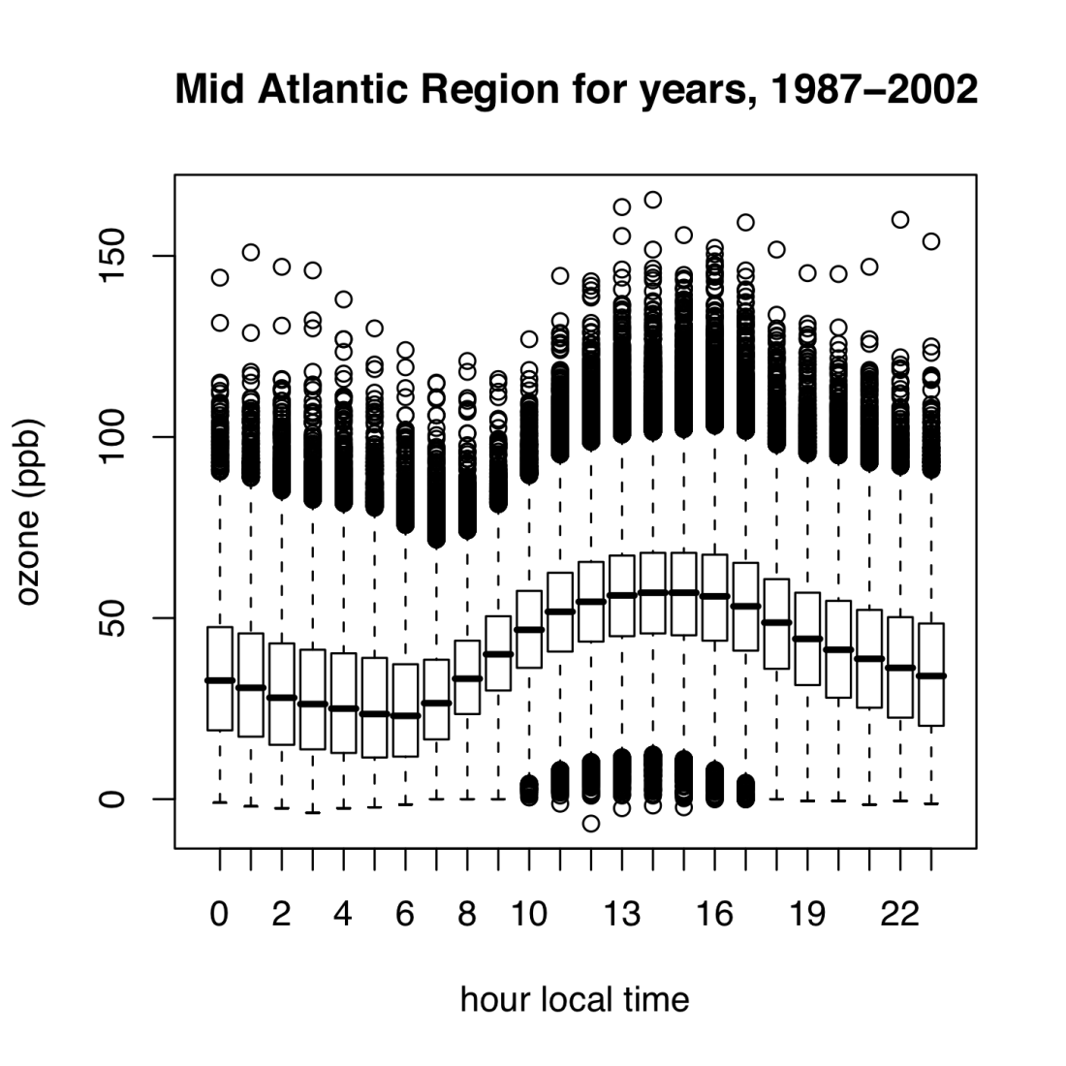

Photochemical smog:
The story of a summer day
Regulatory Ozone Season: May 1 to Sept 30
Rural Ozone
Altitude
Altitude
← Noct. inv.
Temperature
Temperature
Minimum
Early AM
Maximum
Early Afternoon
26
Notes:
Summertime Ozone goes through a cycle every day: driven by meteorology (lots of light = high temps) and low winds
Under high pressure: production-destruction => this cycle as observed….mimimum when loss has continued for many hours unbalanced by production (no sun), sunrises production resumes to the point where production = destruction, just after local solar maximum (noon)
High pressure means air is sinking, therefore no clouds…so lots of sunlight, light winds, and emissions are “capped”
At night the structure of the atmosphere evolves to favor long range transport on regional scales (100’s to 1000 of km)
Power plants emit directly into the residual layer (at least ones with tall stacks) and this gets tranpsorted long distances and makes more pollutants that get mixed down later…
So power plants are imporant, and they are very important on large scales as a result of this chemistry and meteorology.
26

Slide 27
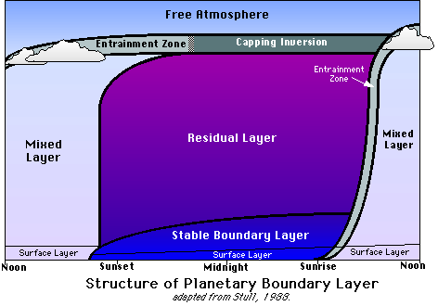
The diurnal evolution of the planetary boundary layer (PBL) while high pressure prevails over land. Three major layers exist (not including the surface layer): a turbulent mixed layer; a less turbulent residual layer which contains former mixed layer air; and a nocturnal, stable boundary layer that is characterized by periods of sporadic turbulence.

Slide 28
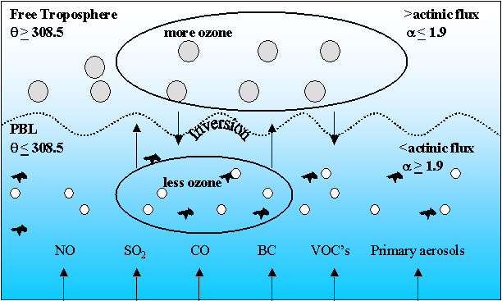
Two Reservoir Model (Taubman et al., JAS, 2004)
H₂SO₄
Cumulus
Cumulus
SO₂

Slide 29
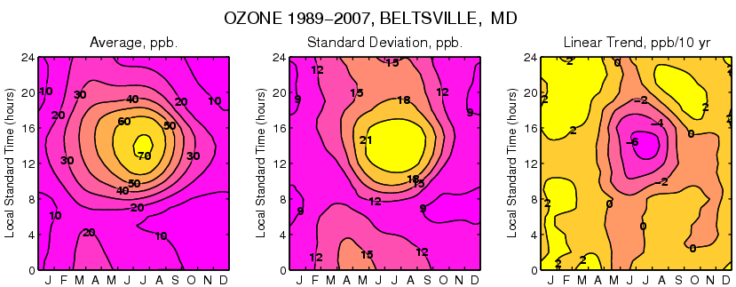
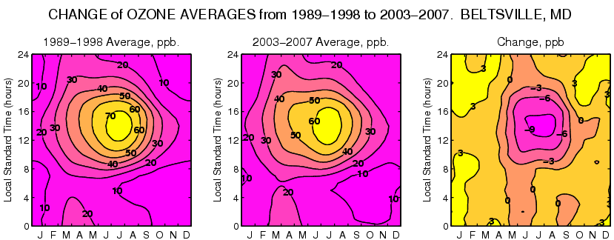

Slide 30
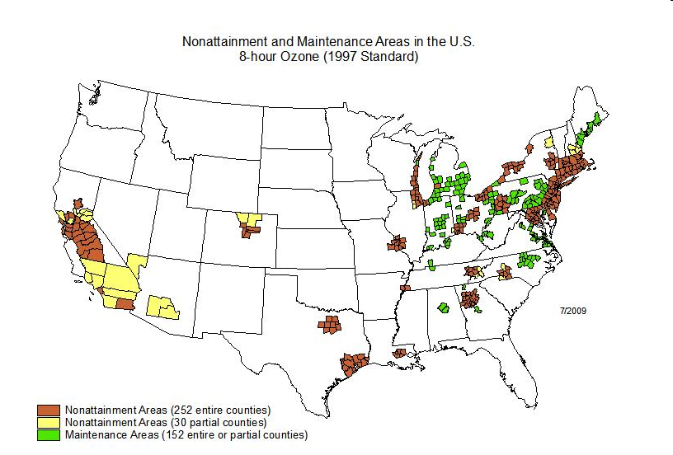
Ozone is a national problem
(85 ppb)
30

Slide 31
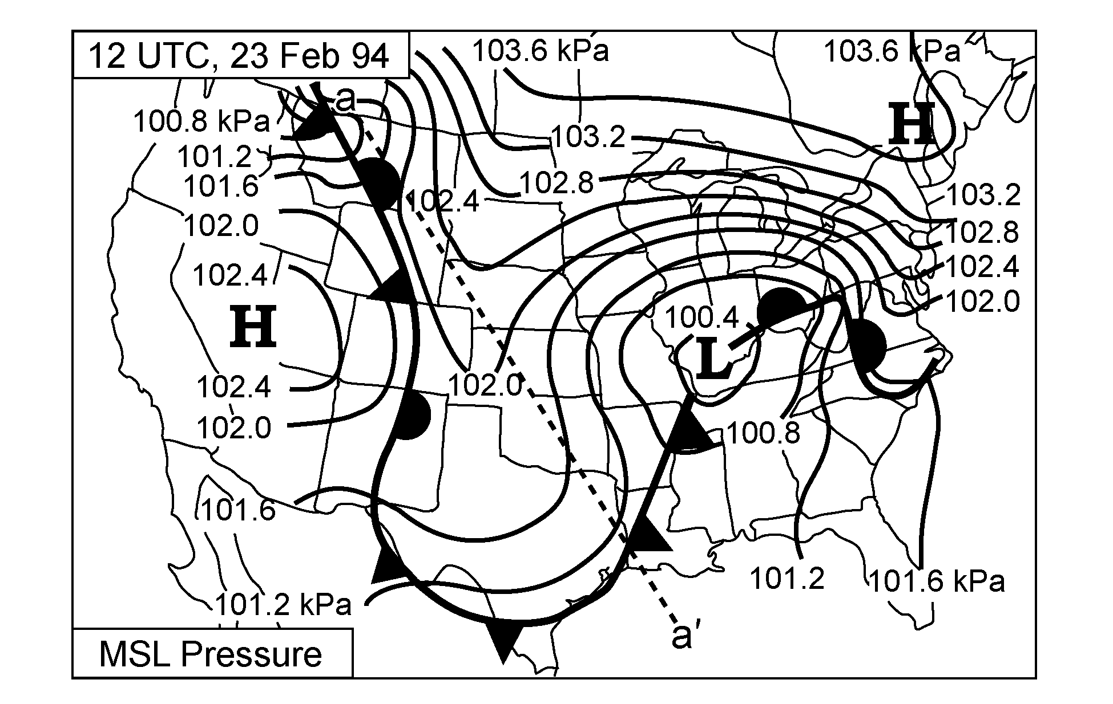
Tropopause folds - a natural source of ozone.
Surface weather chart showing sea level (MSL) pressure (kPa), and surface fronts.

Slide 32
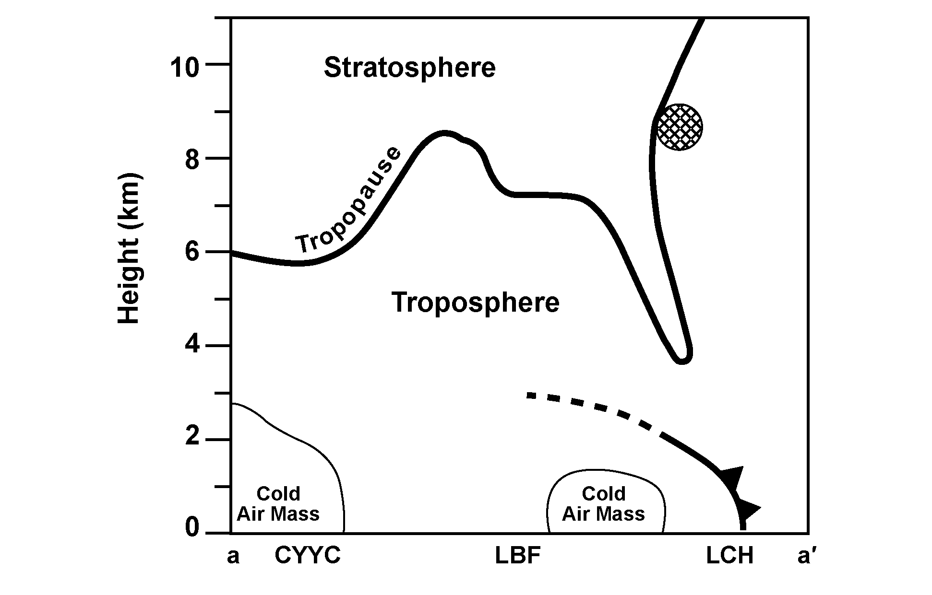
Vertical cross section along dashed line (a-a’) from northwest to the southeast (CYYC = Calgary, Alberta; LBF = North Platte, NB; LCH = Lake
Charles, LA). The approximate location of the jet stream core is indicated by the hatched area. The position of the surface front is indicated by the cold-frontal symbols and the frontal inversion top by the dashed line.
Note: This is 12 h later than the situations shown in previous figure

Slide 33
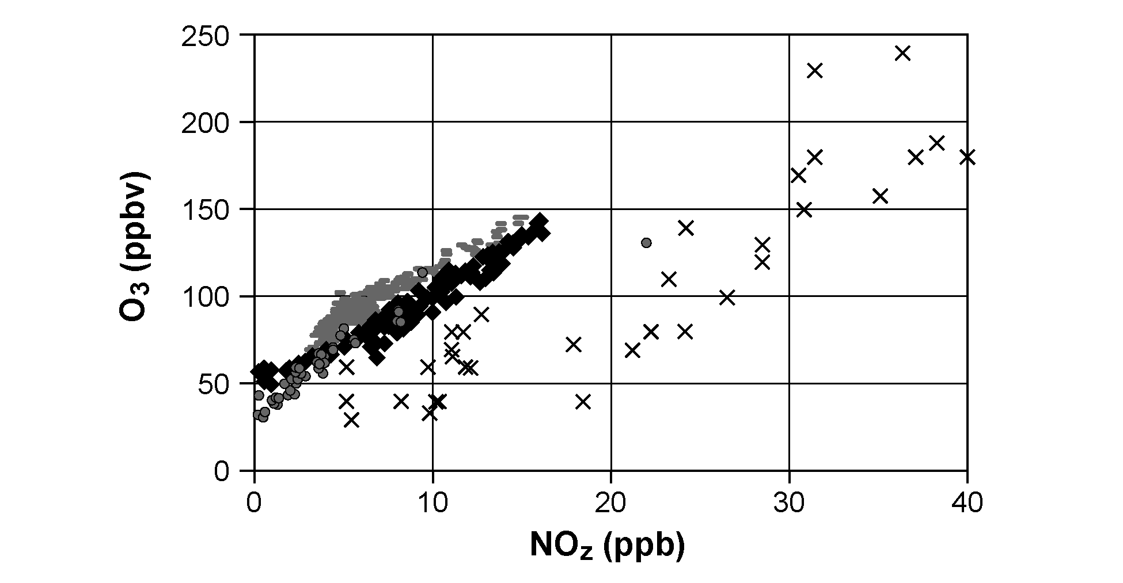
Measured values of O₃ and NOz (NOy – NOx) during the afternoon at rural sites in the eastern United States (grey circles) and in urban areas and urban plumes associated with Nashville, TN (gray dashes); Paris, France (black diamonds); and Los Angeles CA (Xs).
Sources: Trainer et al. (1993), Sillman et al. (1997, 1998), Sillman and He

Slide 34
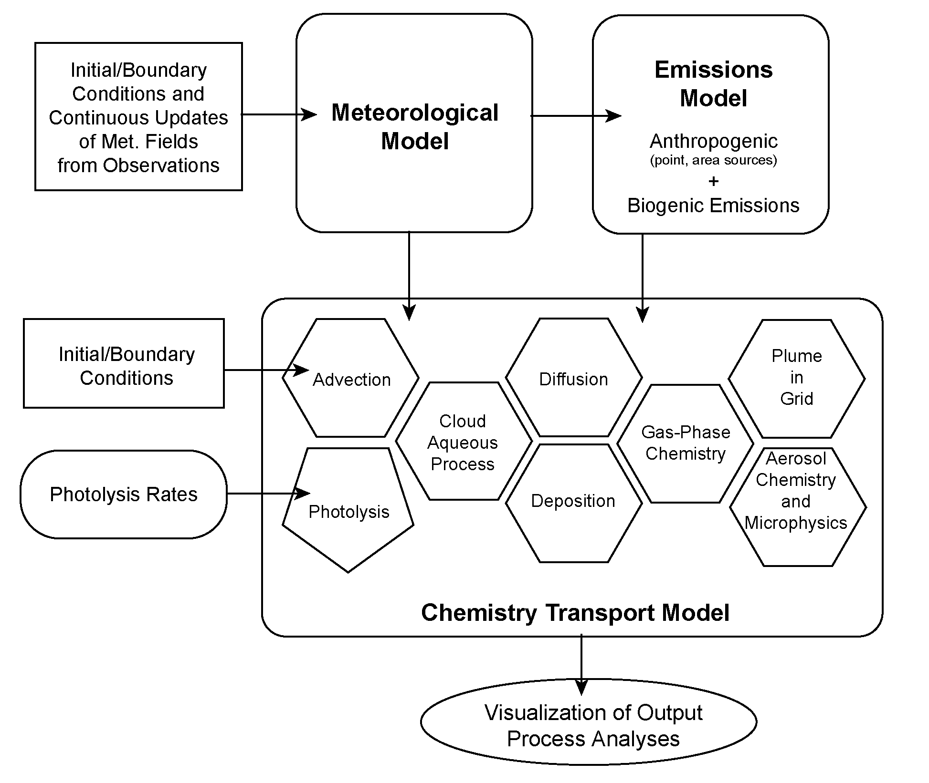
Main components of a comprehensive atmospheric chemistry modeling system, such as CMAQ.

Slide 35
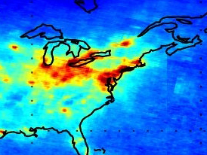
Scia column NO₂ obs.

Slide 36
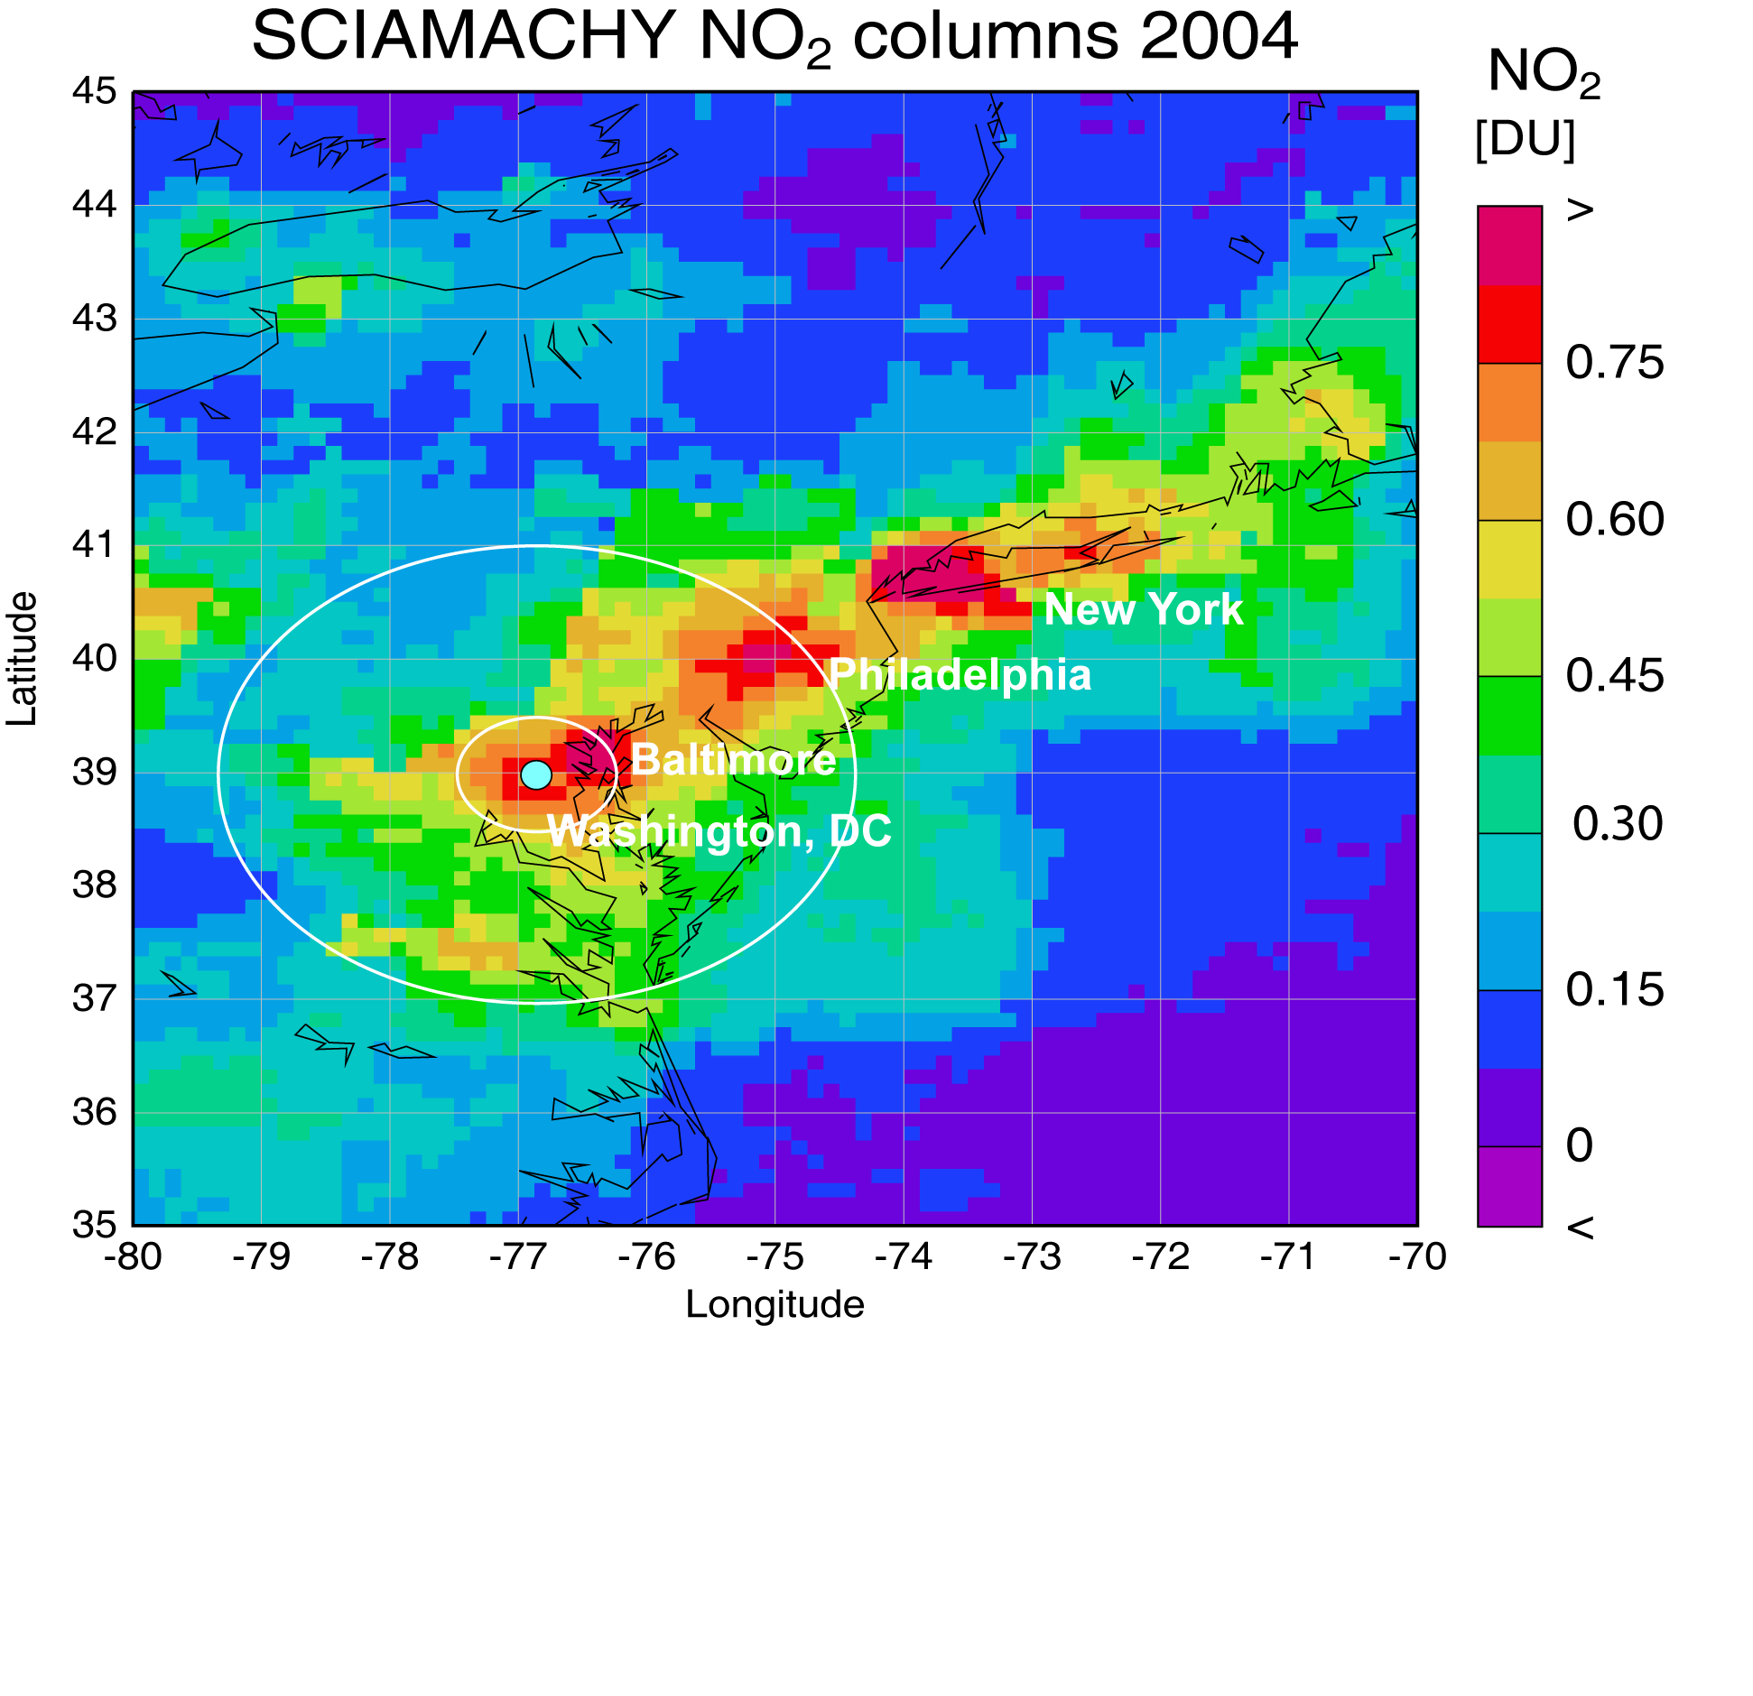
Space-borne NO₂ reveals urban NO_{x} emissions
Tropospheric NO₂ columns derived from SCIAMACHY measurements, 2004.
The NO₂ hot-spots coincide with the locations of the labeled cities.
Herman et al., NCAR Air Quality Remote Sensing from Space, 2006

Slide 37
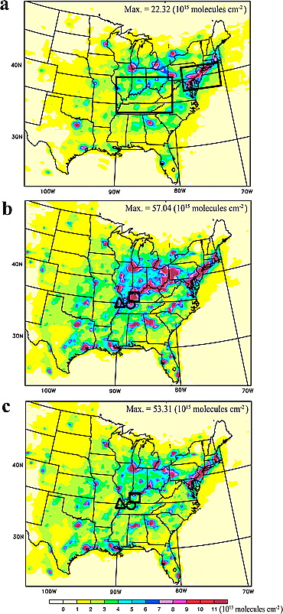
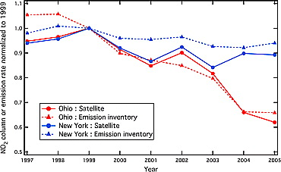
Space-borne NO₂ helps improve emission models and reveals trends in NO_{x} emissions
SCIAMACHY
Measurements
Initial
Model
Model
With
Revised
Emissions
Kim et al., GRL, 2006

Slide 39
Response of ozone to Maximum temperature measured in Baltimore. 1994-2004
39
Notes:
39

Slide 40
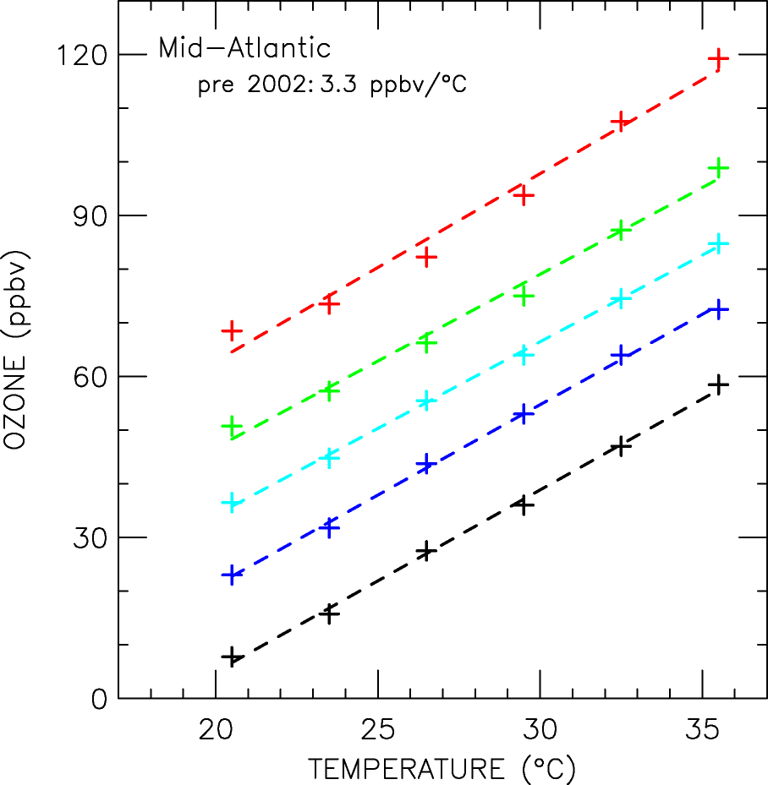
Looking deeper into the data: method
95%
75%
50%
25%
5%
Ozone rises as temperature increases
The slope is defined to be the
“climate penalty factor”
3°C
Temperature Binning
40
Notes:
Or “taking apart the blob”
Conditional distributions constructed using 3C temperature bins.
Plotted at midpoint of each temperature bin.
Results are relatively Insensitive to bin size (less than 0.1 ppb/C difference)
Regress each percentile separately.
Average the slopes.
“Wouldn’t you know, ozone distriubutions behave like republicans and walk in lock step.”
40

Slide 41
Notes:
41

Slide 42
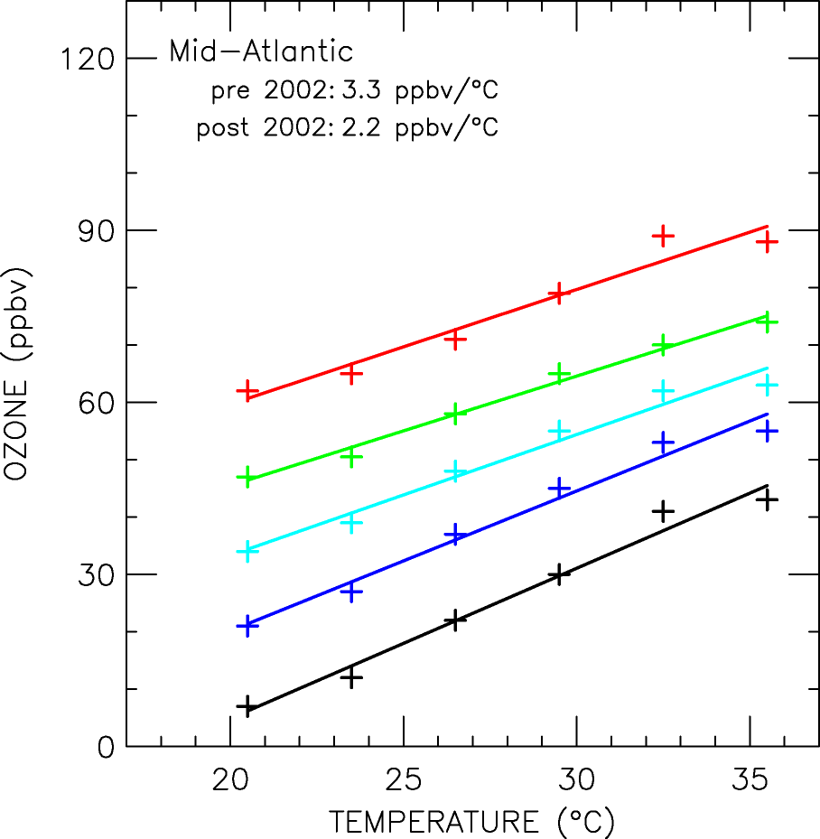
Notes:
42

Slide 43
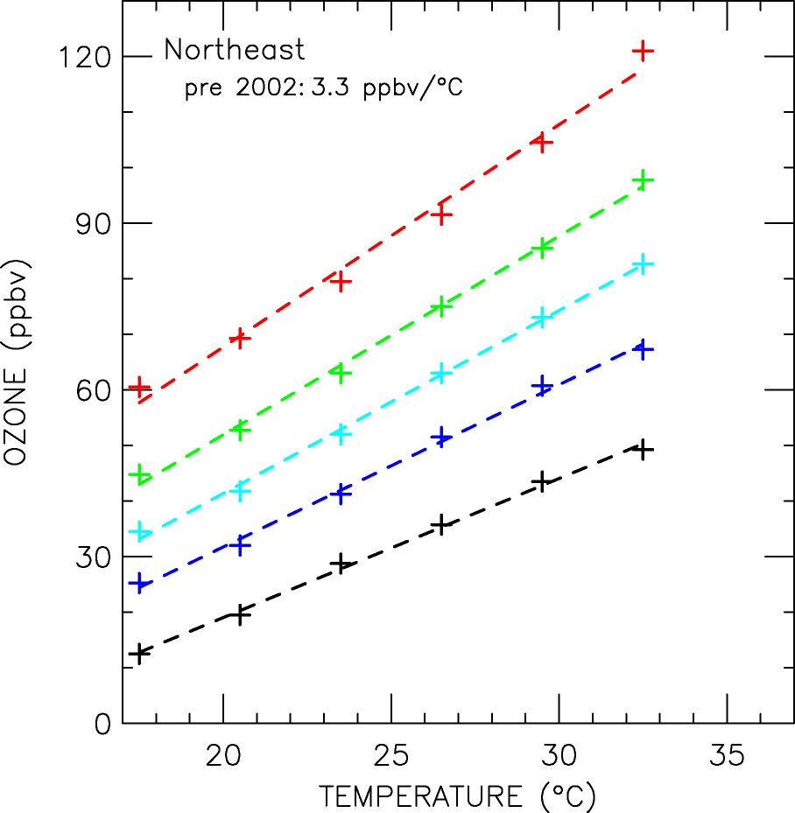
Notes:
43

Slide 44
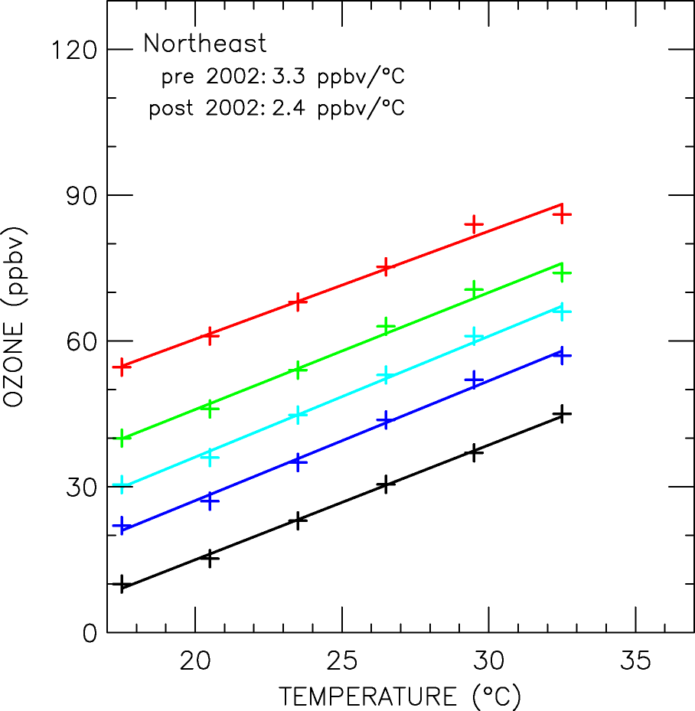
Notes:
44

Slide 45
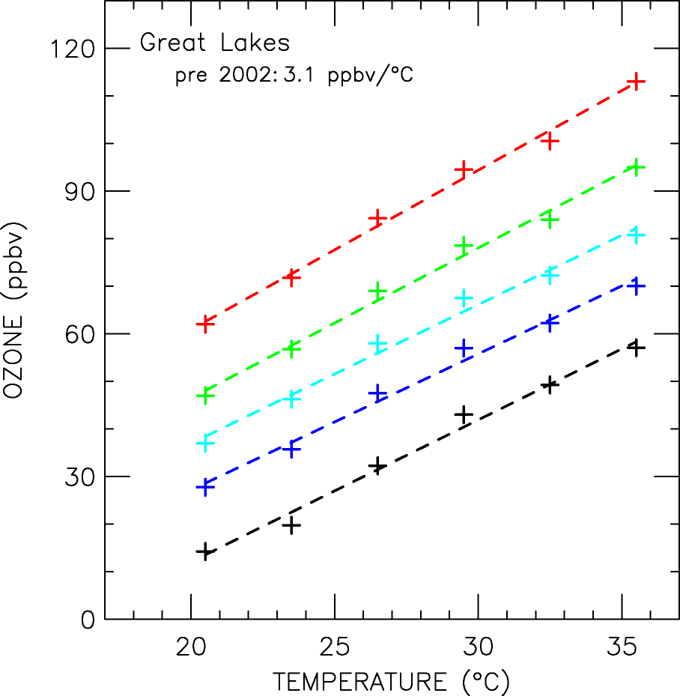
Notes:
45

Slide 46
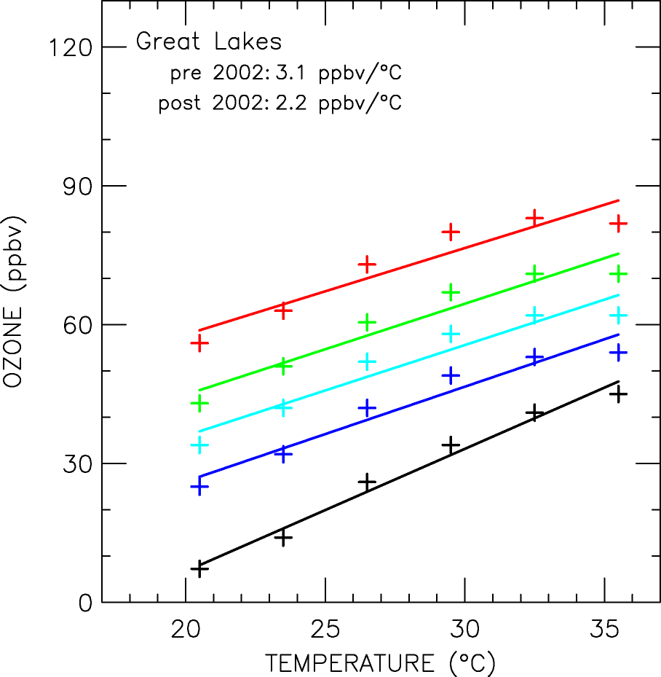
Notes:
46

Slide 47
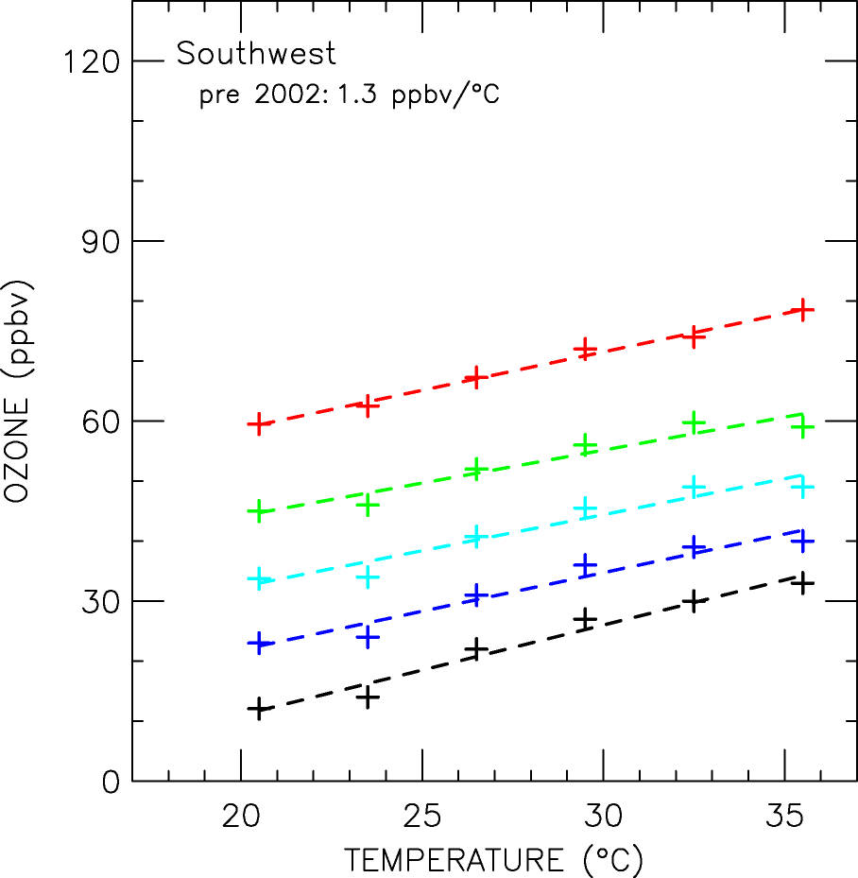
Notes:
47

Slide 48
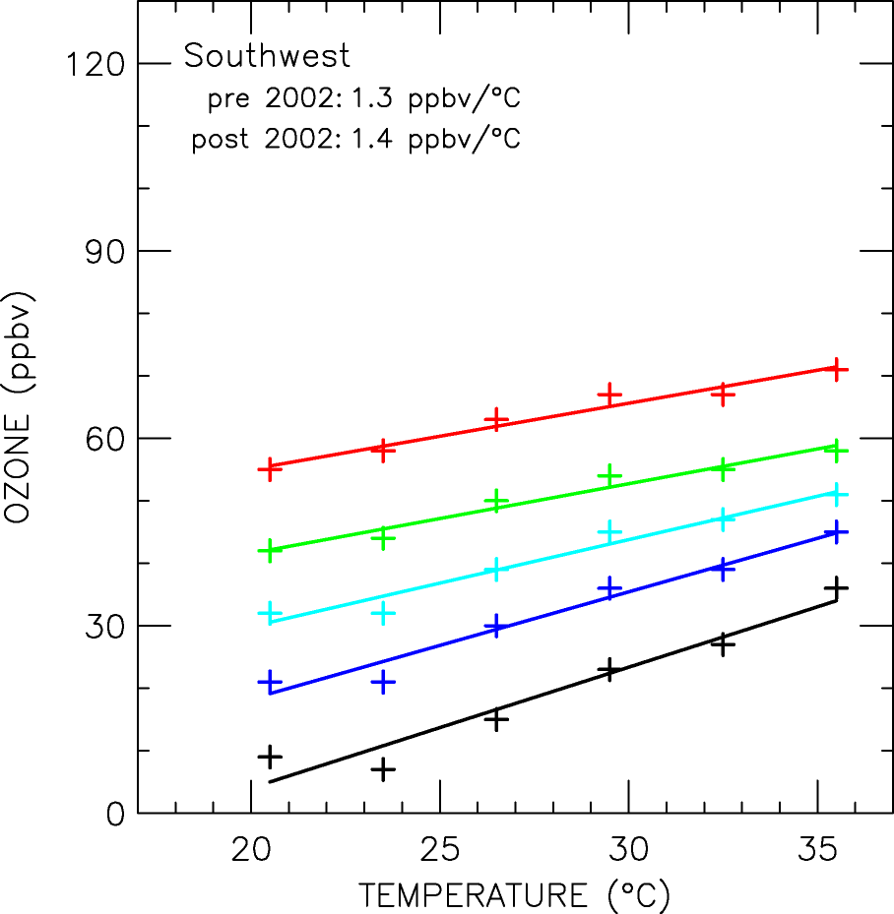
Notes:
48

Slide 49
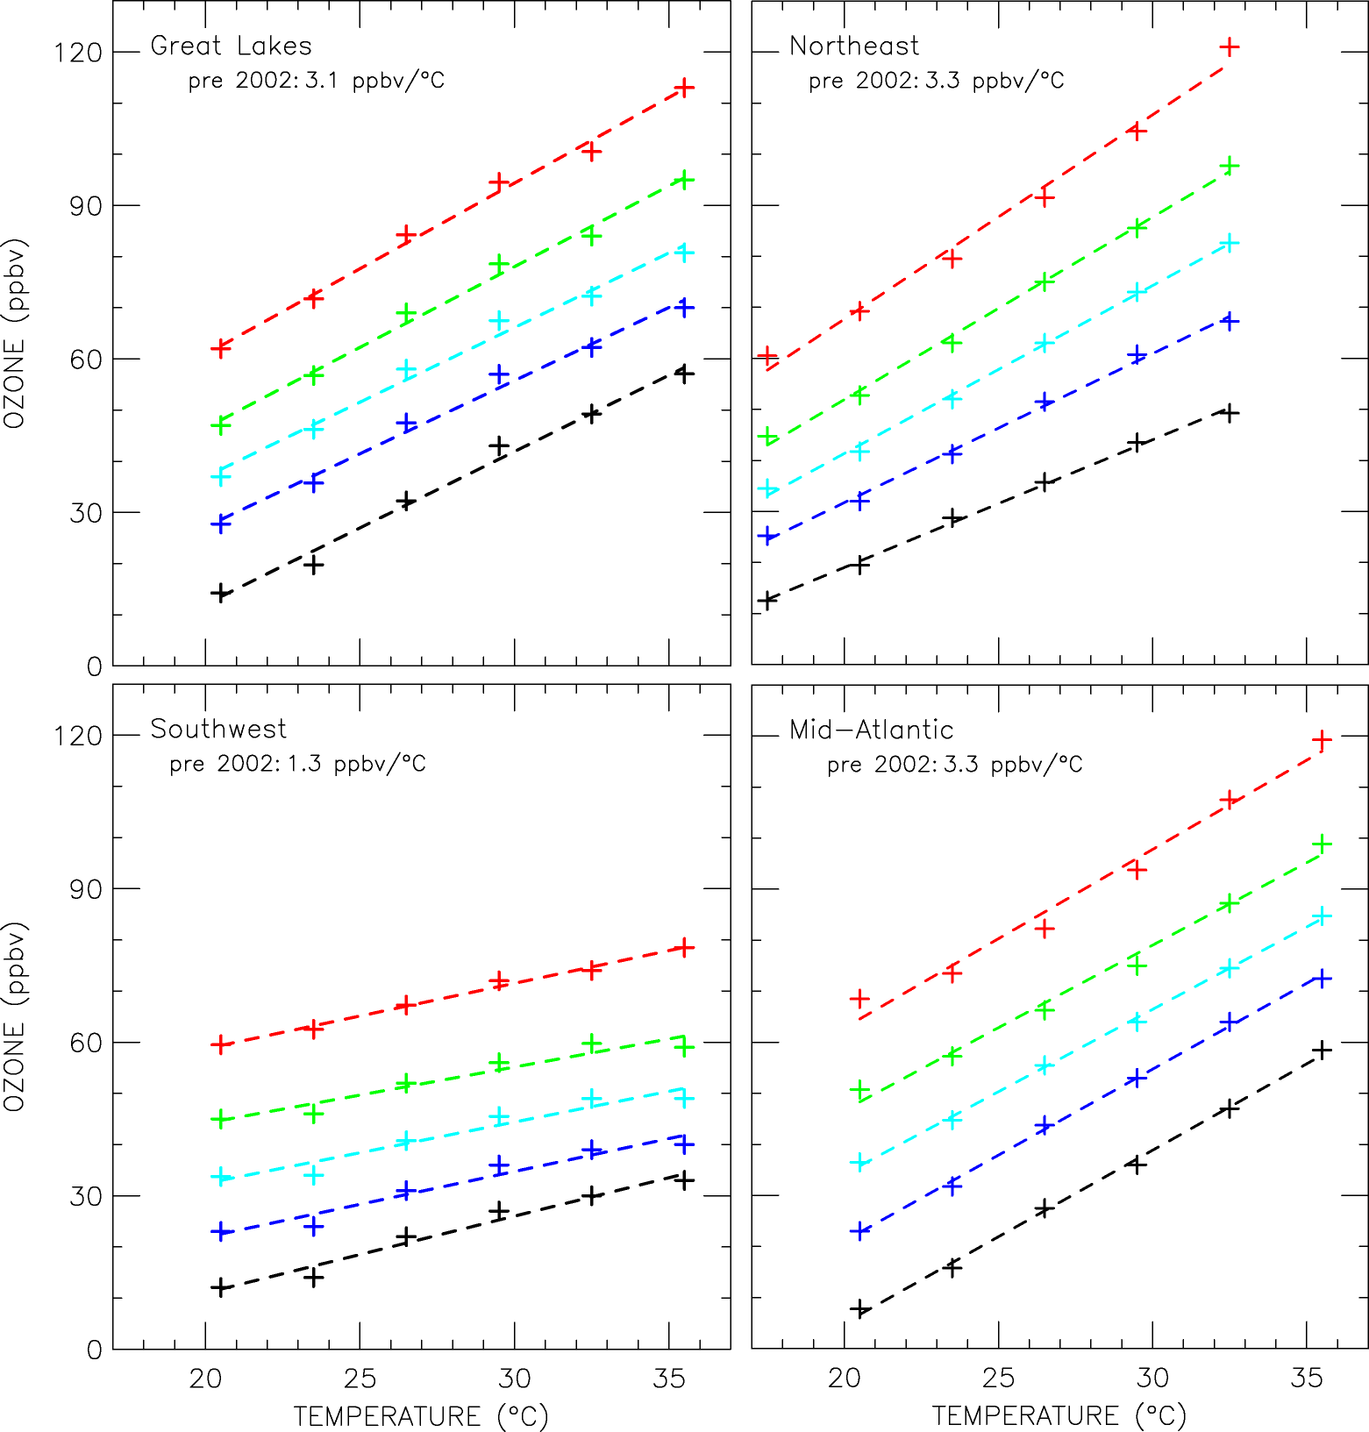
Can we observe the influence of warming on air quality?
95%
75%
50%
25%
5%
Climate Penalty Factors
Consistent
across the distribution
AND
across the power plant
dominated receptor regions
49

Slide 50
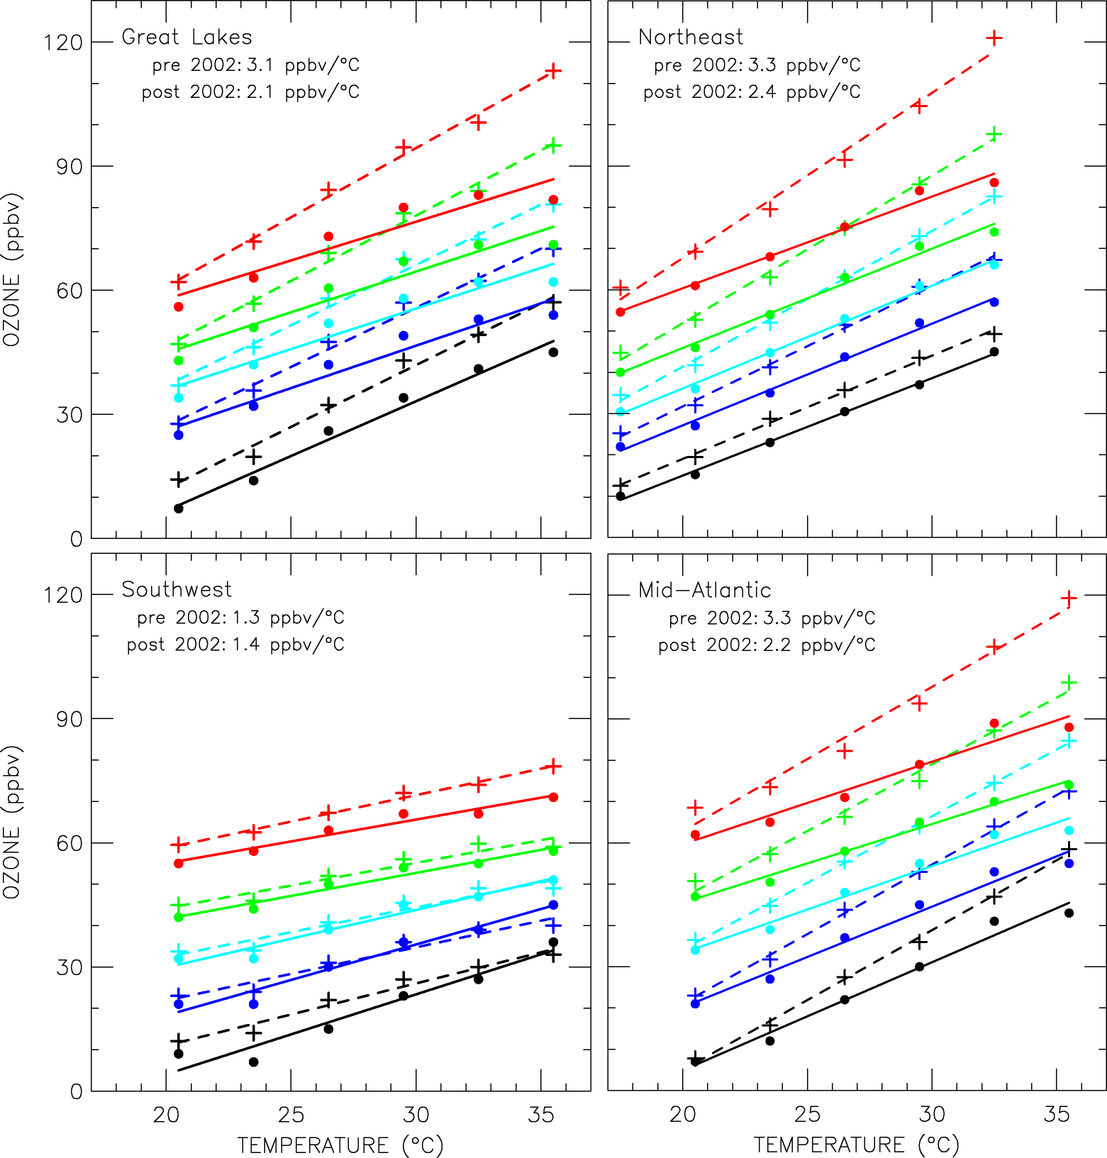
Can we observe the influence of warming on air quality?
Reducing NOx emissions
Lowered
Ozone over the entire distribution
And decreases
the Climate Penalty Factor
95%
75%
50%
25%
5%
The change in the
climate penalty factor is
remarkably consistent across
receptors dominated by
power plant emissions. Ignoring
SW:
The average of
3.3 ppb/°C pre-2002
Drops to
2.2 ppb/°C after 2002
Bloomer et al., Science, 2008
In Review
50
Notes:
50

Slide 51
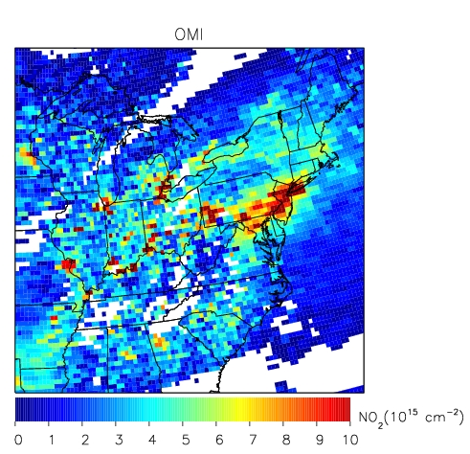
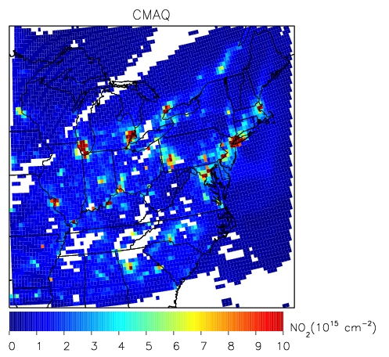
Measurement Model Comparison: NO₂

Slide 52
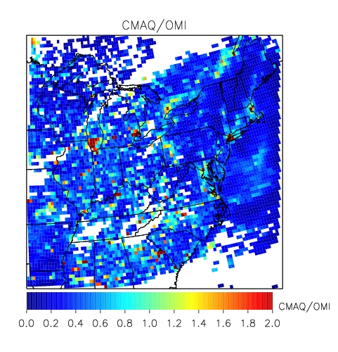
Ratio CMAQ/OMI

Slide 53
Key Concepts
Both meteorology and photochemistry play important roles in local and global ozone chemistry.
Transport from the stratosphere represents a natural source of ozone.
VOC’s plus NOx make a photochemical source.
HOx reactions and dry deposition are sinks.
The lifetime of a species in the mixed layer is the H/V_{d}.

